Slide 1


Lecture 20: Review A blitz through the course
Harvard IACS
Chris Tanner

Slide 2
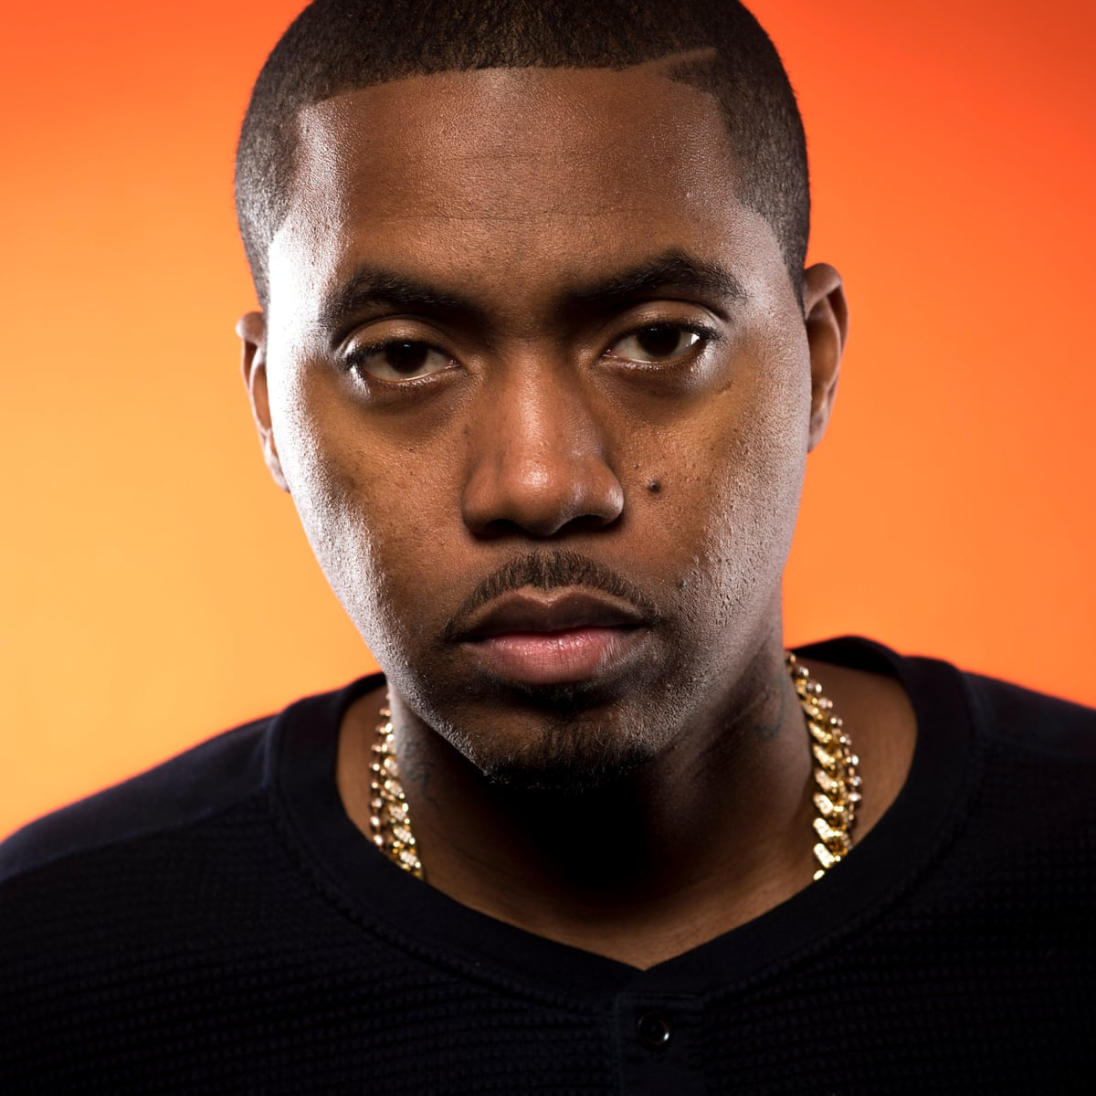

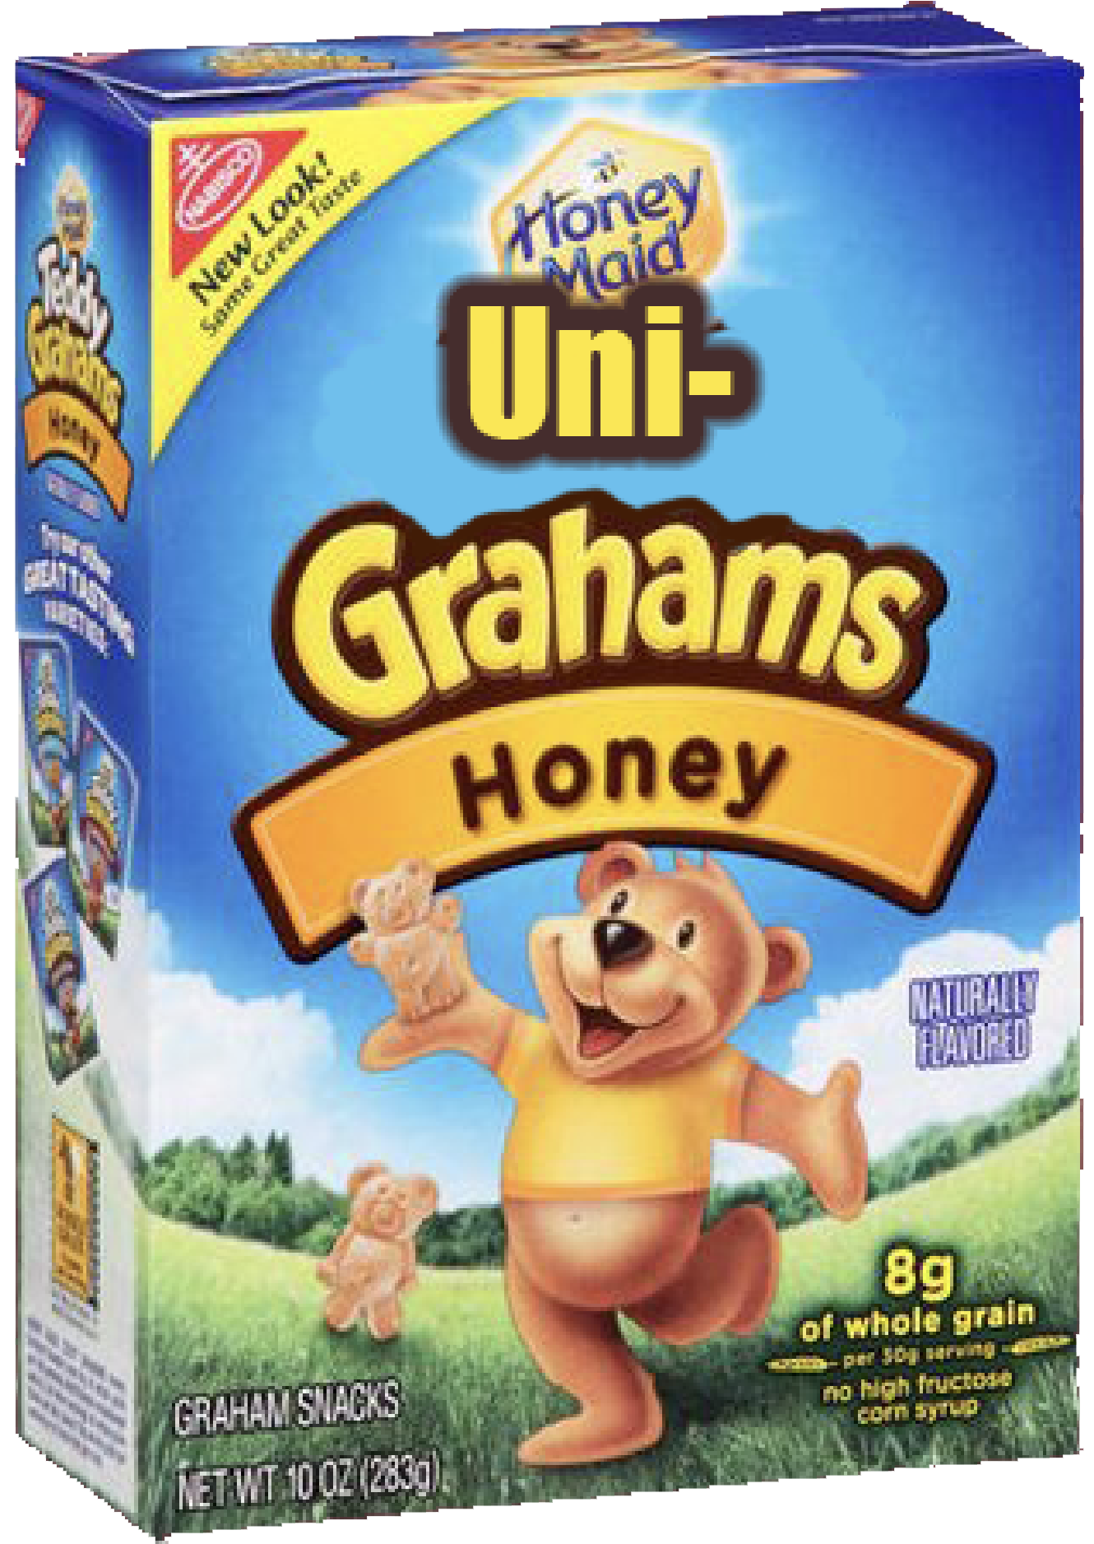
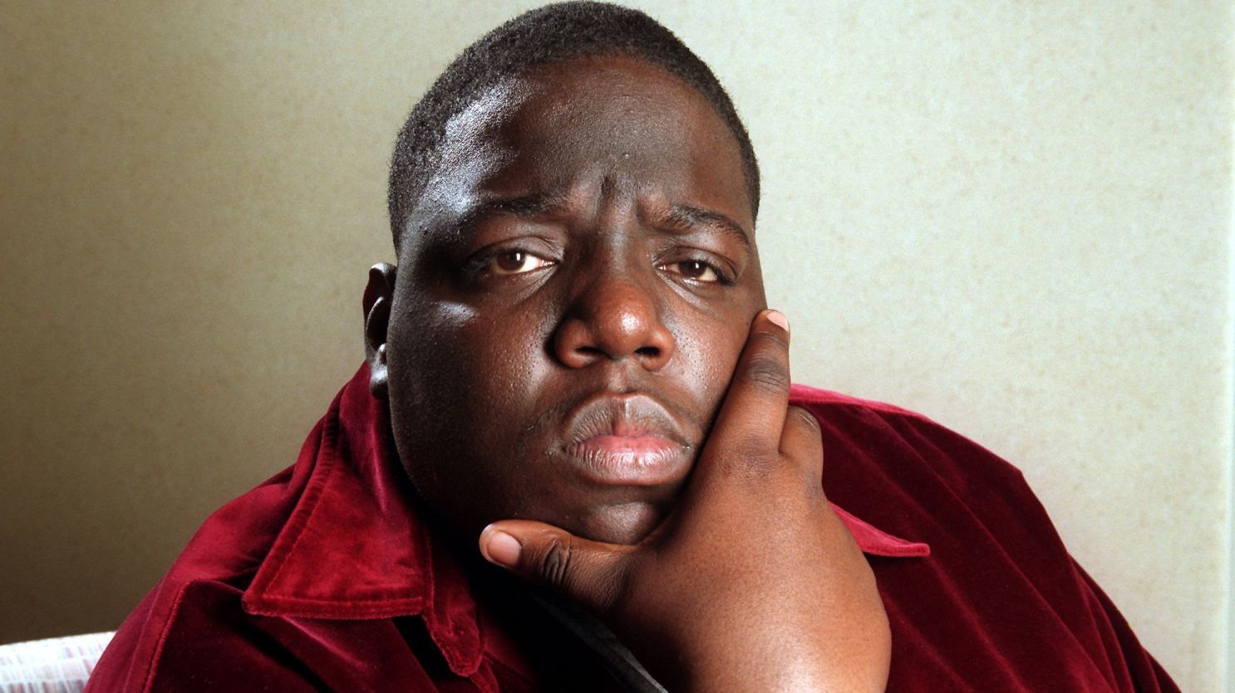
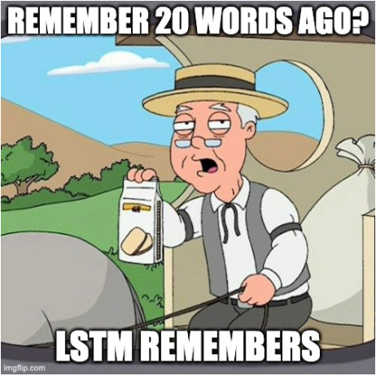

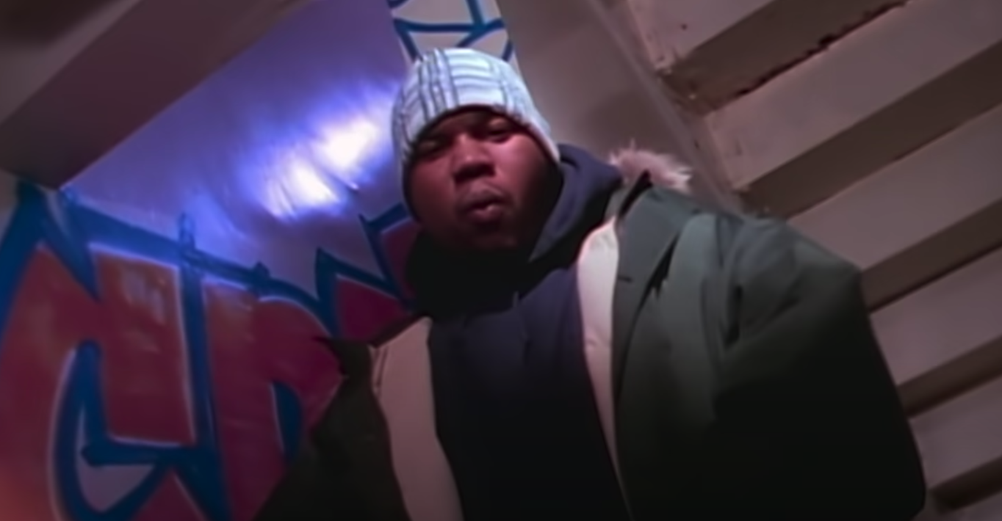


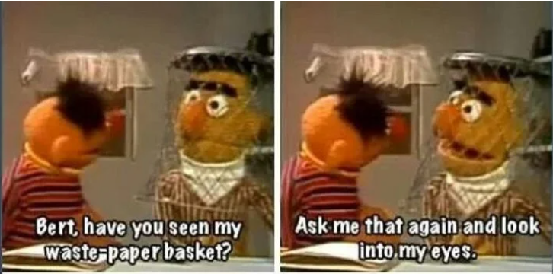
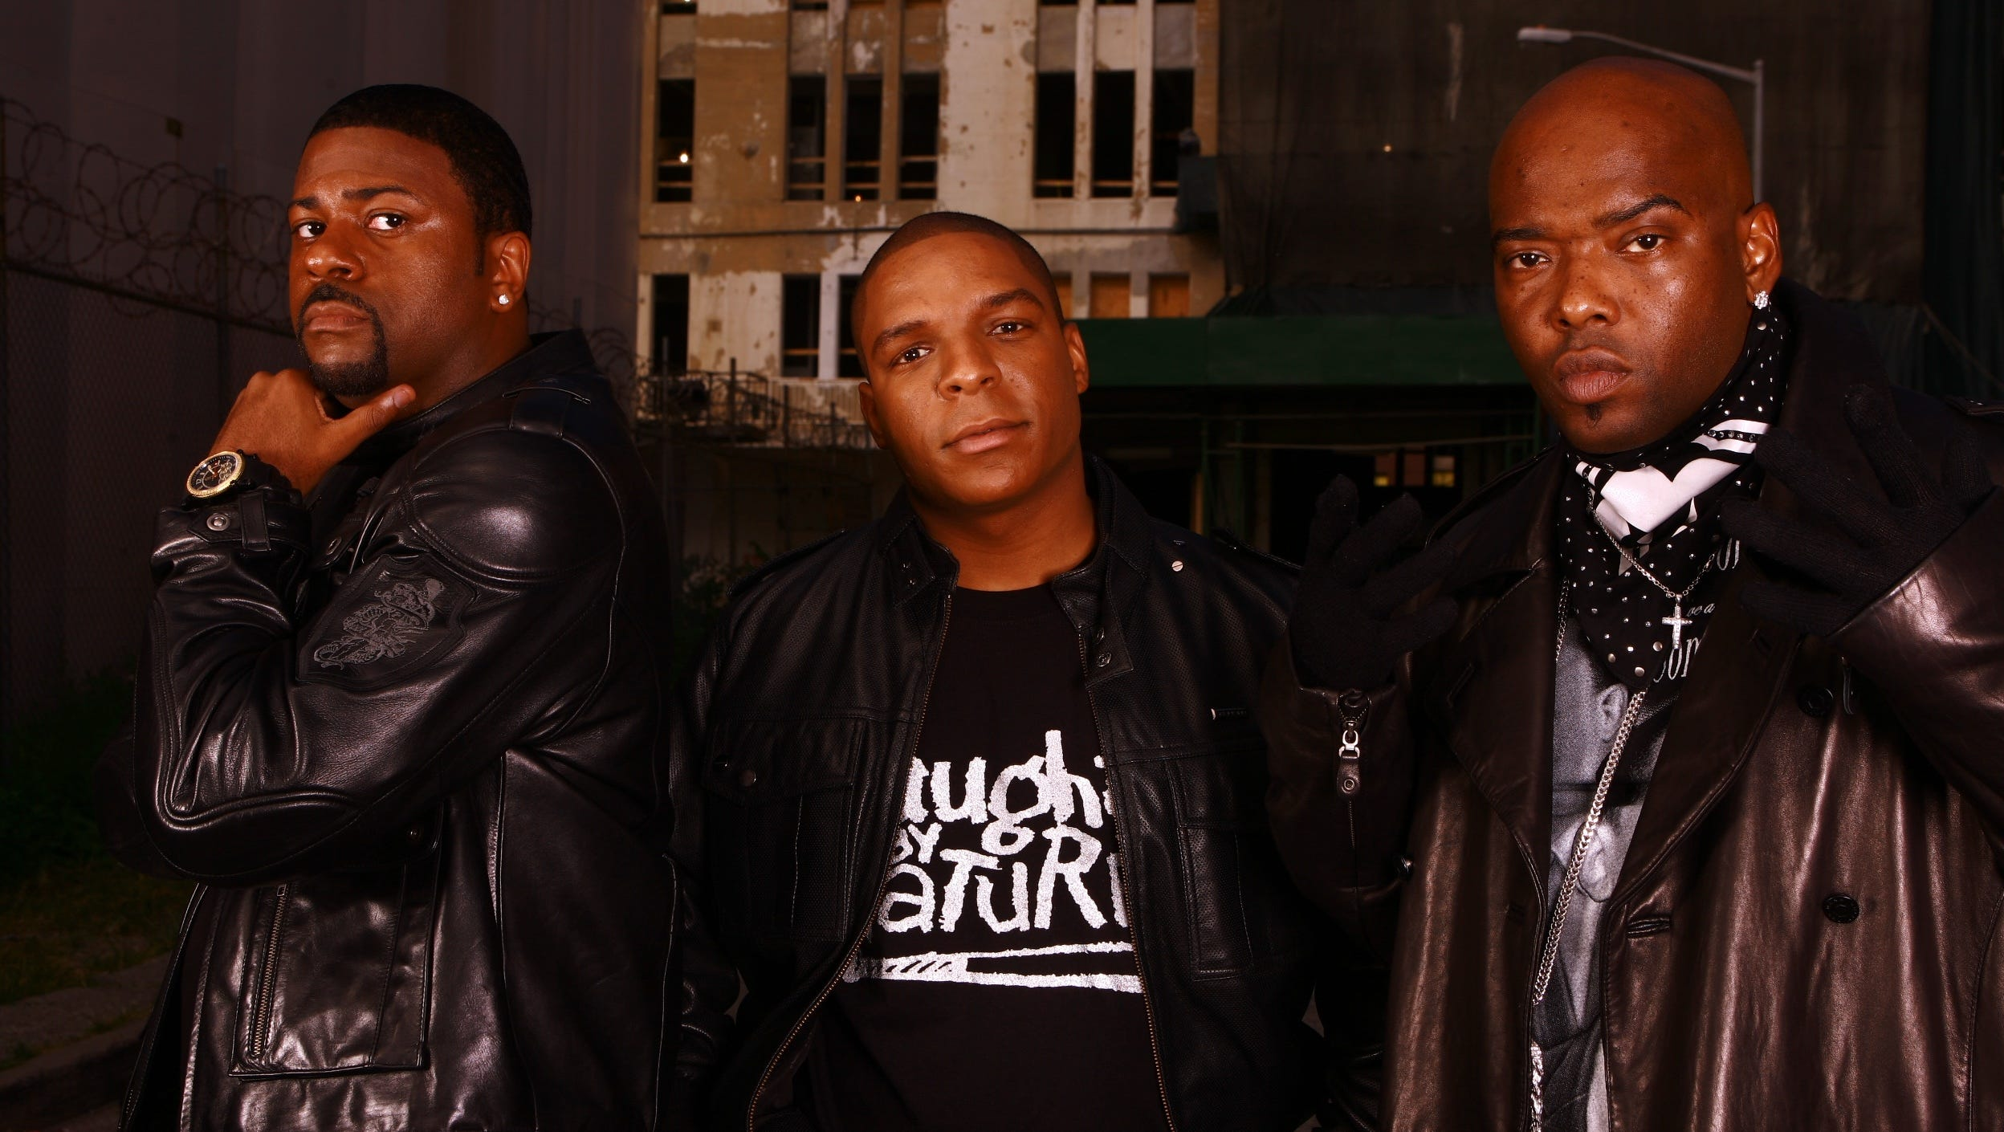

Slide 3
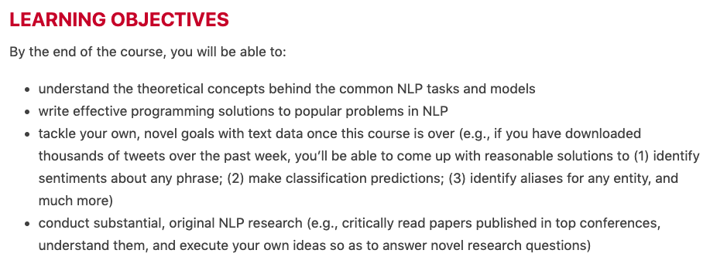

Slide 4
ANNOUNCEMENTS
HW3 is 75% graded
Quiz 6 and Quiz 7 will be graded by tonight
Quiz 8 will be released on Ed’s Sway on Thurs
Phase 3 is 50% graded
Research Project Phase 4 due Thurs night:
Write a bulleted list of what each team member has done
All member must sign it (digitally typing your name is fine)
Submit on Canvas

Slide 5
EXAM
Can include any content that was covered in lecture (not just the content in these slides today)
Many quiz-like questions to test foundational understanding
Some deeper-understanding questions like homework Part 1’s
Some questions about the research papers you’ve read
Possibly 1-2 big problems where you need to design a model
This isn’t exhaustive; I may ask something completely different, too, but this will cover at least 75% of the exam

Slide 6
Outline
Beginning Concepts
Neural Foundation
Attention and Beyond

Slide 7
Outline
Beginning Concepts
Neural Foundation
Attention and Beyond

Slide 8
Lecture 1: Introduction
Course Overview + What is NLP?
Harvard
AC295/CS287r/CSCI E-115B
Chris Tanner

Slide 9



What is this course?
Our digital world is inundated with data, most textual data
62B pages
500M tweets/day
360M user pages
13M articles

Slide 10
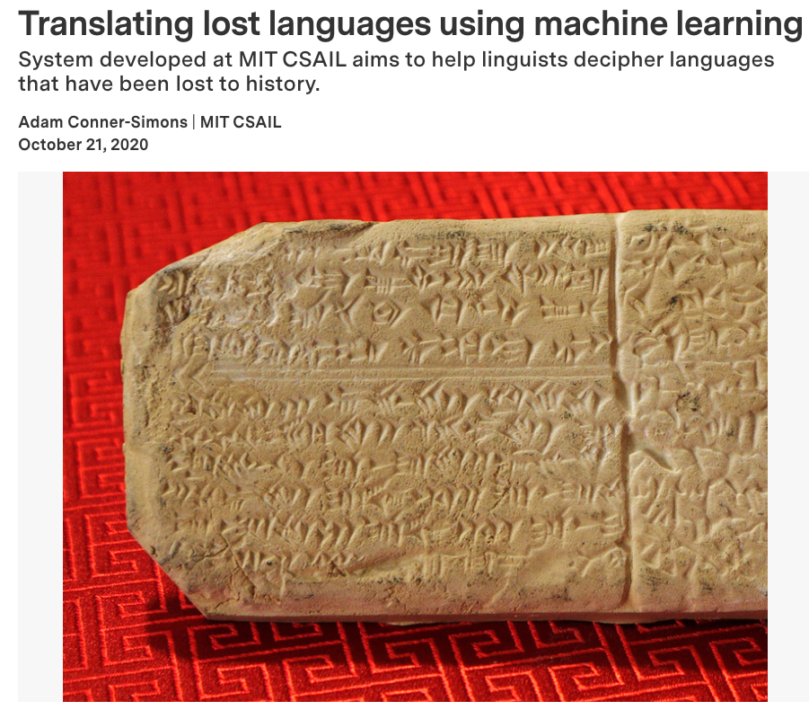
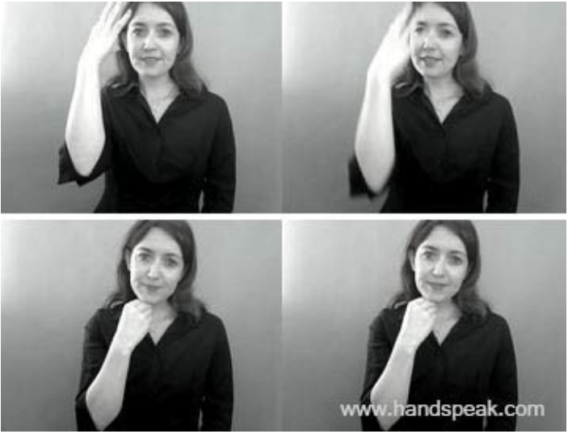
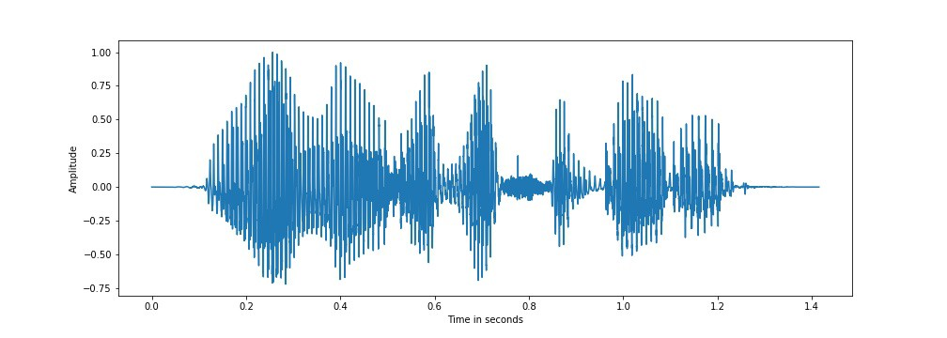
What is this course?
Natural Language Processing (NLP) is the study of how to get computers to process, “understand”, and leverage human language data.
Speech Audio
(Signal Processing work is a cousin community and often done by EE folks)
Written Text
Sign Language
Neural Decipherment via Minimum-Cost Flow: From Ugaritic to Linear B Luo, et al. (2019)
Including Signed Languages in Natural Language Processing Yin, et al. (2021)

Slide 11
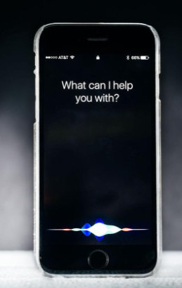
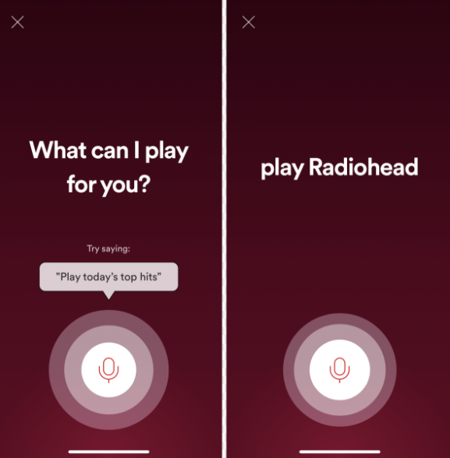
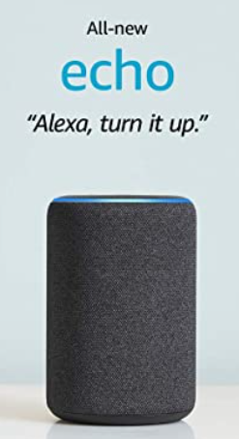



NLP Successes
NLP has been around since the 1960s, but the progress in the past 10 years has been astronomical. Models are becoming effective enough for consumer use.
Voice Assistants

Slide 12

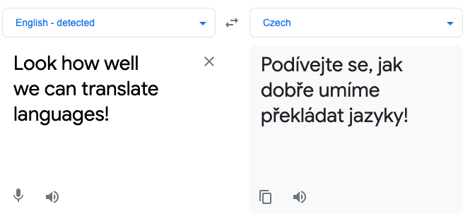
NLP Successes
NLP has been around since the 1960s, but the progress in the past 10 years has been astronomical. Models are becoming effective enough for consumer use.
Translation

Slide 13
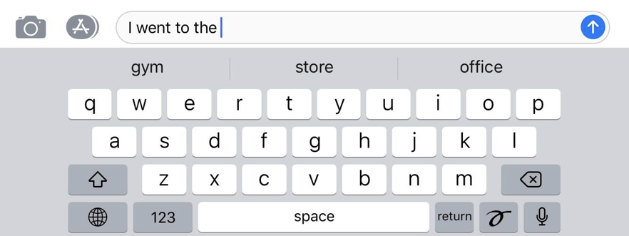
NLP Successes
NLP has been around since the 1960s, but the progress in the past 10 years has been astronomical. Models are becoming effective enough for consumer use.
Auto-complete

Slide 14

NLP Successes
NLP has been around since the 1960s, but the progress in the past 10 years has been astronomical. Models are becoming effective enough for consumer use.
Text Classification

Slide 15
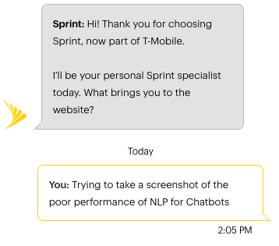
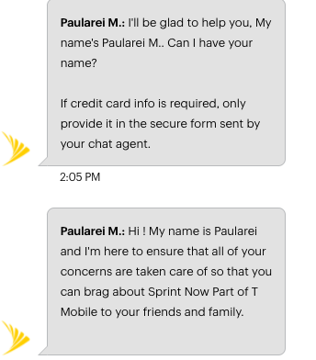
NLP Successes has room for improvement
1.
3.
Chatbots
2.
4.

Slide 16
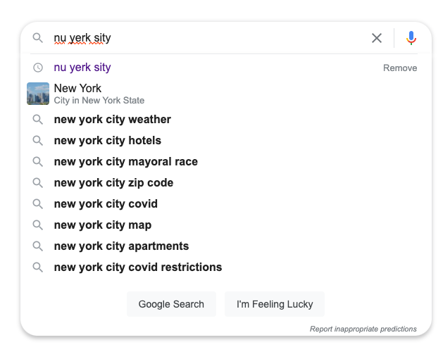
NLP Successes
NLP has been around since the 1960s, but the progress in the past 10 years has been astronomical. Models are becoming effective enough for consumer use.
Search Engines
(information retrieval)

Slide 17
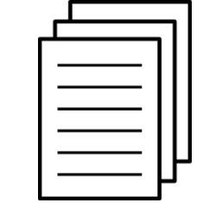
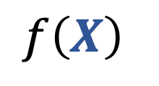
How do these systems work?!
?
English sentences
Machine Translation System
Spanish sentences
X
$$f\left(X\right)$$
Y

Slide 18
How do these systems work?!
For example
While we don’t necessarily have to produce a Y for every NLP problem (i.e., supervised learning), most interesting problems do.
Luckily, we have tons of (X, Y) data pairs, right? Kind of.
?
English sentences
Machine Translation System
Spanish sentences
X
$$f\left(X\right)$$
Y

Slide 19
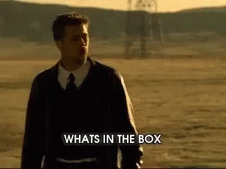
What’s in the box?!
Our computational model could be anything:
Rule-based system
CRF
HMM
Statistical Alignment Model (e.g., IBM Models)
Probabilistic Graphical Model
Neural Network
?
Se7en (1995)
English sentences
Model
Spanish sentences
X
$$f\left(X\right)$$
Y

Slide 20
What’s in the box?!
Regardless of the model, it doesn’t actually “understand” language. It simply approximates understanding for a particular objective. This seems good enough.
?
English sentences
Model
Spanish sentences
X
$$f\left(X\right)$$
Y

Slide 21
Learning Objectives
understand the theoretical concepts behind NLP tasks and models
Not just a surface-level understanding of LSTMs, Transformers;
What is the model actually doing? How does it work? Why does it work? What are its limitations? Past approaches? What are alternatives?
write effective programming solutions to popular problems in NLP
tackle your own, novel goals with text data once this course is over
conduct substantial, original NLP research
I want everyone to finish the course feeling confident and empowered to develop NLP solutions and embark on novel research

Slide 22
Why so research-heavy?
Researcher:
What is possible to build?
How can we use existing blocks in new ways?
What are the limitations of current blocks?
Software Developer:
The Builders. Creators.
Interested in tools to build better, quicker, organized, useful structures
Manager:
Bridges everyone’s skills to make great things actually happen
Image source: lego.com

Slide 23
Expectations of you
Expected to demonstrate not only the ability to understand the core concepts of this course, but to be able to do some research, i.e.:
read papers beyond what's mentioned in class
critique other papers (even if the concepts are new to you)
be curious
come up w/ questions
try to answer these questions
I expect you to challenge yourself. This class is intended to be challenging (but not too challenging).

Slide 24
Expectations of me
I want this course to be an incredibly rewarding experience and the best CS class you take. I pushed to create this course and offer it. Huge thanks to IACS, DCE, CS, and higher-up folks at SEAS for approving it.
Hold me accountable to make it as equitable, fair, clear, and smooth of an experience as possible. I gladly welcome anonymous feedback at any time, and I solicit such as part of each HW assignment.
If something needs improving, let’s work to make it better. I’m here to help you all learn and succeed in this course.

Slide 25
Assessment
All course assessment is structured around 3 pillars:
Building a foundation of theory/concepts (pop-quizzes and exam)
Demonstrating you can apply the knowledge (homework)
Creating new knowledge (12-week research project)

Slide 26
Assessment
foundation
application
creating knowledge
Pop quizzes
(10%)
Exam
(10%)
Homeworks
(30%)
Research project
(50%)

Slide 27
Language is funny
“Red tape holds up new bridges”
“Hospitals are sued by 7 foot doctors”
“Local high school dropouts cut in half”
“Tesla crashed today”
“Obama announced that he will run again”
“Kipchoge announced that he will run again”
“She made him duck”
“Will you visit the bank across from the river bank? You can bank on it”
“Yes” vs “Yes.” vs “YES” vs “YES!” vs “YAS” vs “Yea”

Slide 28
Why study NLP?

Slide 29
NLP: why
The entire point of computers is to assist humans.
Having computers ”understand” our language and how we communicate as a species is a natural entry point and required step to significantly assisting us in our lives.

Slide 30
What are some NLP tasks?

Slide 31
Common NLP Tasks (aka problems)
Syntax
Semantics
Morphology
Word Segmentation
Part-of-Speech Tagging
Parsing
Constituency
Dependency
Sentiment Analysis
Topic Modelling
Named Entity Recognition (NER)
Relation Extraction
Word Sense Disambiguation
Natural Language Understanding (NLU)
Natural Language Generation (NLG)
Machine Translation
Entailment
Question Answering
Language Modelling
Discourse
Summarization
Coreference Resolution

Slide 32
What are some trends of NLP over the decades?

Slide 33
Very brief history of NLP
1960s: pattern-matching and rules (highly limiting)
1970s – 1980s: linguistically rich, logic-driven systems; labor-intensive successes on a few, very specific tasks
1990s – 2000s: statistical modelling takeover! ML becomes a central component; some systems are deployed for practical use (e.g., speech to text)
2010s – 2020s: Deep Learning (neural nets) yields astronomical progress on nearly every NLP task; systems become fairly useful for consumers
2020s – 2030s?: you can help drive the change
Slide adapted from or inspired by Sam Bowman

Slide 34
Very brief history of NLP
First huge revolution: early 1990s (statistical approaches)
“But it must be recognized that the notion ‘probability of a sentence’ is an entirely useless one, under any known interpretation of this term”
-- Noam Chomsky (1969)
“Anytime a linguist leaves the group, the recognition rate goes up”
-- Fredrick Jelinek (1988)

Slide 35
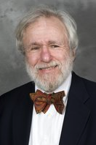
Very brief history of NLP
First huge revolution: early 1990s (statistical approaches)
“I refer to all of my work before ~1990 as the B.S. era. That is, ‘before statistics’”
-- paraphrasing my PhD adviser, Eugene Charniak at his ACL Lifetime Achievement Award (2011)

Slide 36
NLP nowadays
GPT-2 (generates text and can fine-tune on your own data)
SYSTEM PROMPT (HUMAN-WRITTEN)
A train carriage containing controlled nuclear materials was stolen in Cincinnati today. Its whereabouts are unknown.
MODEL COMPLETION (MACHINE-WRITTEN, FIRST TRY)
The incident occurred on the downtown train line, which runs from Covington and Ashland stations.
In an email to Ohio news outlets, the U.S. Department of Energy said it is working with the Federal Railroad Administration to find the thief.
“The theft of this nuclear material will have significant negative consequences on public and environmental health, our workforce and the economy of our nation,” said Tom Hicks, the U.S. Energy Secretary, in a statement. “Our top priority is to secure the theft and ensure it doesn’t happen again.”
The stolen material was taken from the University of Cincinnati’s Research Triangle Park nuclear research site, according to a news release from Department officials.
The Nuclear Regulatory Commission did not immediately release any information.

Slide 37
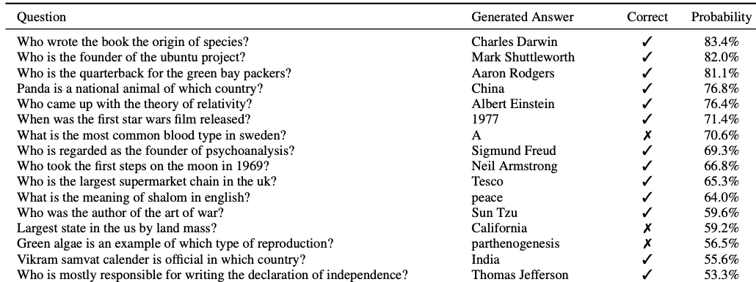
NLP nowadays
GPT-2 (generates text and can fine-tune on your own data)

Slide 38
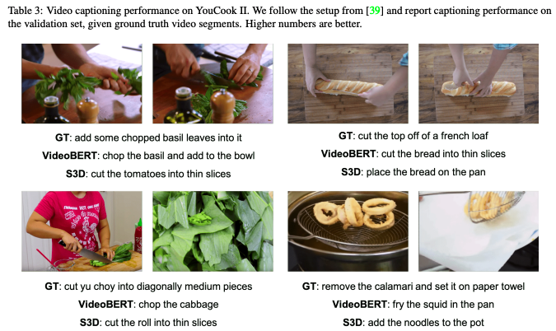
NLP nowadays
VideoBERT: A Joint Model for Video and Language Representation Learning. Sun, et al. ICCV 2019.

Slide 39
What constitutes Deep Learning?

Slide 40
Deep Learning
Deep Learning is just neural networks with more than 1 hidden layer (non-linear activation functions).
For the 1st time ever, one paradigm of modelling (deep learning) yields the best results across nearly every domain of problems
Our understanding of why and how the results are so compelling is very surface-level.
Much work lies ahead (e.g., bias/fairness, explainability, robustness)

Slide 41
What are the two “cornerstones” of NLP?

Slide 42
The Two Cornerstones of NLP
How do we get any system to process, ”understand”, leverage language?
Representation: how do we transform symbolic meaning (e.g., words, signs, braille, speech audio) into something the computer can use
Modelling: given these represented symbols, how do we use them to model the task at hand?

Slide 43
Lecture 2: Language Representations
What is NLP + How to represent language
Harvard
AC295/CS287r/CSCI E-115B
Chris Tanner

Slide 44
What are some of the linguistic levels that NLP addresses?

Slide 45
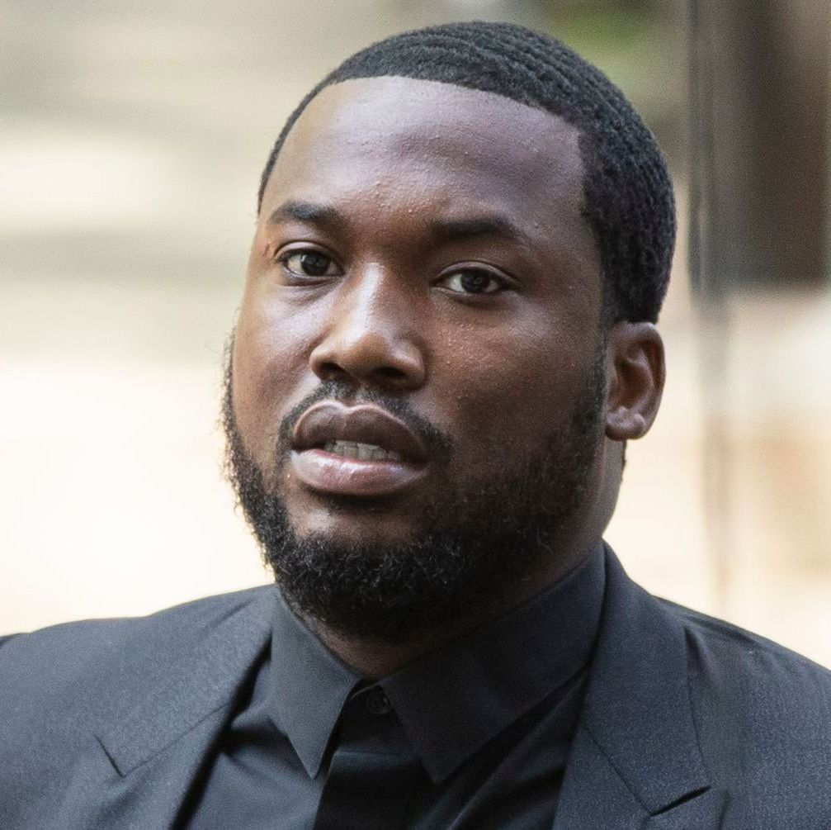
Multiple levels* to a single word
Discourse
Pragmatics
Semantics
Syntax
Lexemes
Morphology
*
phonology
orthography
phonetics
text
speech
Slide adapted from or inspired by Chris Manning and Richard Socher

Slide 46
Representing Images
170
33
71
r
g
b
Meaningful relation between the byte values and color.
Notes:
Intensities are conveyed. Darker red. Lighter green. All colors are perfectly captured and we the relationships are perfectly captured. How much darker or lighter? A: half of the range darker.

Slide 47
Representing Images
255
33
71
r
g
b
Meaningful relation between the byte values and color.
Thus, colors, and images at large, are well-represented.

Slide 48
Representing Language
Words are represented by Strings
a
t
e
61
74
65
Each byte corresponds to language’s smallest meaningful unit! Yay!
But, no meaningful relation between the byte values and language!

Slide 49
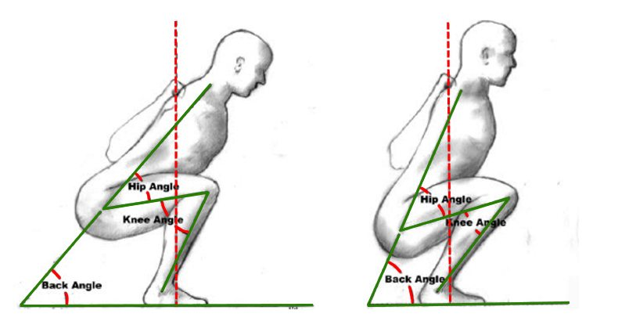
Representing Language
Words are represented by Strings
a
t
g
61
74
67
A.T.G. is, however, more intense. Never mind. Ignore this slide.

Slide 50
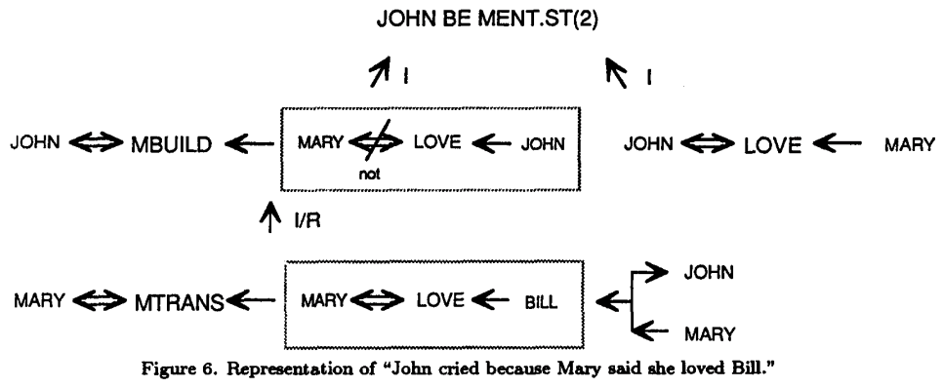
Conceptual Dependencies
Conceptual Dependency and its Descendants. Lytinen, S.L. Computers, Mathematics, and Applications (1992)
Notes:
CD’s add to predicate-calculus by “recommending” predicates to be used

Slide 51
What are some external NLP data resources we can use?

Slide 52
External Resources
There are rich, external resources that define real-world relationships and concepts
(e.g., WordNet, BabelNet, PropBank, VerbNet, FrameNet, ConceptNet)

Slide 53
WordNet
A large lexical database with English nouns, verbs, adjectives, and adverbs grouped into over 100,000 sets of cognitive synonyms (synsets) – each expressing a different concept.
Most frequent relation: super-subordinate relation (”is-a” relations).
{furniture, piece_of_furniture}
Fine-grained relations: {bed, bunkbed}
Part-whole relations: {chair, backrest}
Synonyms: {adept, expert, good, practiced, proficient}

Slide 54
ConceptNet
A multilingual semantic knowledge graph, designed to help computers understand the meaning of words that people use.
Started in 1999. Pretty large now.
Finally becoming useful (e.g, commonsense reasoning)
Has synonyms, ways-of, related terms, derived terms

Slide 55
What are some pros and cons of using external resources?

Slide 56
Limitations
Great resources but ultimately finite
Can’t perfectly capture nuance (especially context-sensitive) (e.g., ‘proficient’ is grouped with ‘good’, which isn’t always true)
Will always have many out-of-vocabulary terms (OOV) (e.g., COVID19, Brexit, bet, wicked, stankface, “no cap”)
Subjective
Laborious to annotate
Words with the same spelling are doomed to be imprecise

Slide 57
What is a “bag-of-words” model/representation?

Slide 58
Bag-of-words (BoW)
Let’s say our dataset’s entire vocabulary is just 10 words. Each unique word can have its own dimension (feature index).
dog
the
quick
went
brown
a
jumped
fast
over
store
[ 0 0 0 0 0 0 0 0 0 0 ]
NOTE: This is the Boolean version, which isn’t the most popular BoW representation

Slide 59
Bag-of-words (BoW)
Each document’s vector has a 1 if the word is present. Otherwise, 0.
e.g., “the dog jumped” is represented as
dog
the
quick
went
brown
a
jumped
fast
over
store
[ 1 1 0 0 0 0 1 0 0 0 ]
NOTE: This is the Boolean version, which isn’t the most popular BoW representation

Slide 60
Bag-of-words (BoW)
Each document’s vector has a 1 if the word is present. Otherwise, 0.
e.g., “the dog went fast” is represented as
dog
the
quick
went
brown
a
jumped
fast
over
store
[ 1 1 0 1 0 0 0 1 0 0 ]
NOTE: This is the Boolean version, which isn’t the most popular BoW representation

Slide 61
Bag-of-words (BoW)
NOTE: The most common way of referring to this is as a “bag-of-words model”. Technically, the “bag-of-words” is referring to the representation, not the model.
“bag-of-words model” actually means “Model that uses a bag-of-words representation”

Slide 62
Pros and cons of BoW?

Slide 63
Bag-of-words (BoW)
Weaknesses:
Flattened view of the document
Context-insensitive (“the horse ate” = “ate the horse”)
Curse of Dimensionality (vocab could be over 100k)
Orthogonality: no concept of semantic similarity at the word-level
e.g., $d($dog, cat) =$d($dog, chair)

Slide 64
What is TF-IDF?

Slide 65
TF-IDF
Notice that longer documents will naturally have higher counts than shorter documents.
baseball
chicago
cubs
the
wringley
padres
shohei
mvp
homerun
crowd
[ 2 9 17 8 0 2 0 0 0 2 ]

Slide 66
TF-IDF
Also notice that “the” has a fairly high count, too.
baseball
chicago
cubs
the
wringley
padres
shohei
mvp
homerun
crowd
[ 2 9 17 8 0 2 0 0 0 2 ]

Slide 67
TF-IDF
Simple ideas. Let’s:
disproportionately weight the common words that appear in many documents
Use that info and combine it with the word frequency info

Slide 68
TF-IDF
TF (term frequency) = $fw_{i}$ = # times word $w_{i}$ appeared in the document
IDF (inverse document frequency) = $log⁡$($\frac{\text{\# }\text{docs} \text{in} \text{corpus}}{\text{\# }\text{docs} \text{containing}{ w}_{i}}$)
TFIDF = $fw_{i}$ * $log⁡$($\frac{\text{\# }\text{docs} \text{in} \text{corpus}}{\text{\# }\text{docs} \text{containing}{ w}_{i}}$)

Slide 69
TF-IDF
Weaknesses:
Flattened view of the document
Context-insensitive (“the horse ate” = “ate the horse”)
Curse of Dimensionality (vocab could be over 100k)
Orthogonality: no concept of semantic similarity at the word-level
e.g., $d($dog, cat) =$d($dog, chair)

Slide 70
TF-IDF
Weaknesses:
Flattened view of the document
Context-insensitive (“the horse ate” = “ate the horse”)
Curse of Dimensionality (vocab could be over 100k)
Orthogonality: no concept of semantic similarity at the word-level
e.g., $d($dog, cat) =$d($dog, chair)
Next lecture, we’ll address this

Slide 71
TF-IDF
Weaknesses:
Flattened view of the document
Context-insensitive (“the horse ate” = “ate the horse”)
Curse of Dimensionality (vocab could be over 100k)
Orthogonality: no concept of semantic similarity at the word-level
e.g., $d($dog, cat) =$d($dog, chair)
In the following lecture, we’ll address these points

Slide 72
Lecture 3: Language Models
The backbone of NLP
Harvard
AC295/CS287r/CSCI E-115B
Chris Tanner

Slide 73
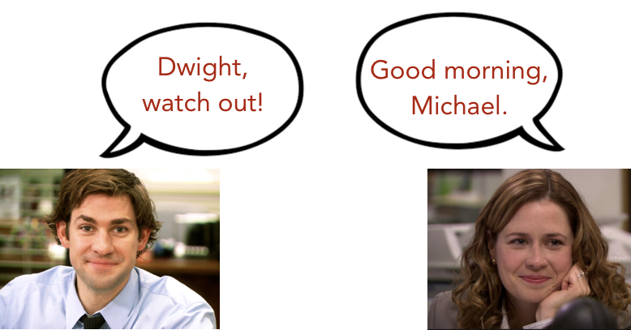
Language Modelling
A Language Model represents the language used by a given entity (e.g., a particular person, genre, or other well-defined class of text)

Slide 74
Language Modelling
FORMAL DEFINITION
A Language Model estimates the probability of any sequence of words
Let $X$ = “Anqi was late for class”
$$w_{1}$$
$$w_{2}$$
$$w_{3}$$
$$w_{4}$$
$$w_{5}$$
$P(X)$ = $P$(“Anqi was late for class”)

Slide 75
What is LM used for?

Slide 76
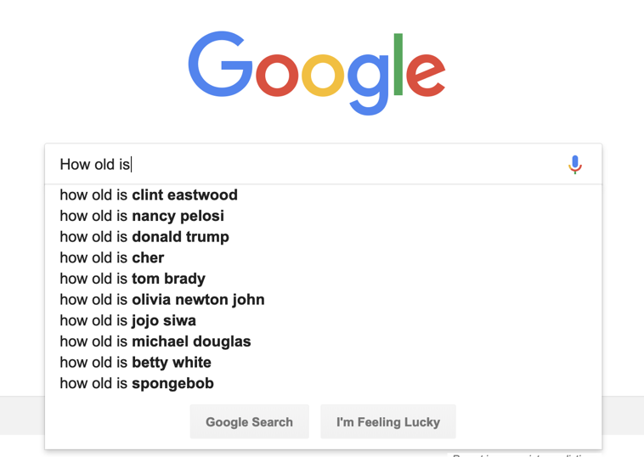
Language Modelling
Generate Text

Slide 77
Language Modelling
A Language Model is useful for:
Generating Text
Classifying Text
Auto-complete
Speech-to-text
Question-answering / chatbots
Machine translation
Summarization
Authorship attribution
Detecting spam vs not spam
Grammar Correction
And much more!

Slide 78
Language Modelling
Slide adapted from Luke Zettlemoyer @ UW 2018
Scenario: assume we have a finite vocabulary $V$
$V∗$represents the infinite set of strings/sentences that we could construct
e.g., $V∗$= {a, a dog, a frog, dog a, dog dog, frog dog, frog a dog, …}
Data: we have a training set of sentences $x∈V∗$
Problem: estimate a probability distribution:
$$p\left(the\right)={10}^{−2}$$
$$\sum_{x∈V∗}{p\left(x\right)}=1$$
$$p\left(the, sun, okay\right)=2.5x{10}^{−13}$$
$$p\left(waterfall,the,icecream\right)=3.2x{10}^{−18}$$

Slide 79
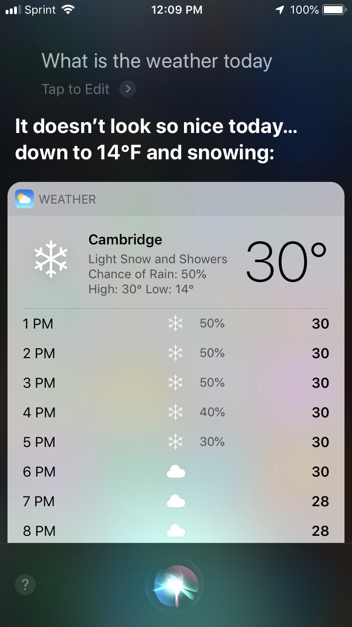
Motivation
“Wreck a nice beach” vs “Recognize speech”
“I ate a cherry” vs “Eye eight uh Jerry!”
“What is the weather today?”
“What is the whether two day?”
“What is the whether too day?”
“What is the Wrether today?”

Slide 80
Important Terminology
a word token is a specific occurrence of a word in a text
a word type refers to the general form of the word, defined by its lexical representation
If our corpus were just “I ran and ran and ran”, you’d say we have:
6 word tokens [I, ran , and , ran , and , ran]
3 word types: {I, ran, and}

Slide 81
Language Modelling
Naive Approach: unigram model
$$P\left(w_{1}, …, w_{T}\right)=\prod_{t=1}^{T}{p(wt)}$$
Assumes each word is independent of all others.
$P(w_{1}, w_{2}, w_{3}, w_{4}, w_{5})$ = $P(w_{1}),P(w_{2}),P\left(w_{3}\right)P\left(w_{4}\right)P(w_{5})$

Slide 82
Unigram Model
Let’s say our corpus $d$ has 100,000 words
Let $X$ = “Anqi was late for class”
$$w_{1}$$
$$w_{2}$$
$$w_{3}$$
$$w_{4}$$
$$w_{5}$$
word | # occurrences
Anqi | 15
was | 1,000
late | 400
for | 3,000
class | 350
$P(w_{i})$ = $\frac{n_{w_{i}}(d)}{n_{w_{∗}}(d)}$
$P(Anqi)$ = $\frac{15}{100,000}=0.00015$
$$n_{w_{∗}}(d)=100,000$$
$P(was)$ = $\frac{1,000}{100,000}=0.01$
$n_{w_{i}}(d)$ = # of times word $w_{i}$appears in $d$
$n_{w_{∗}}(d)$ = # of times any word $w$appears in $d$

Slide 83
Unigram Model
Let $X$ = “Anqi was late for class”
$$w_{1}$$
$$w_{2}$$
$$w_{3}$$
$$w_{4}$$
$$w_{5}$$
$P\left(Anqi,was,late,for,class\right)= P\left(Anqi\right)P\left(was\right)$ $P\left(late\right)$ $P\left(for\right)$ $P\left(class\right)$
$$=0.00015∗0.01∗0.004∗0.03∗0.0035$$
$$=6.3∗10−13$$
This iterative approach is much more efficient than dividing by all possible sequences of length 5

Slide 84
UNIGRAM ISSUES?
1. Probabilities become too small
2. Out-of-vocabulary words <UNK>
3. Context doesn’t play a role at all
$P$(“Anqi was late for class”) $=P$(“class for was late Anqi”)
4. Sequence generation:
What’s the most likely next word?
Anqi was late for class _____
Anqi was late for class the
Anqi was late for class the the

Slide 85
UNIGRAM ISSUES?
Problem 1: Probabilities become too small
$$P\left(w_{1}, …, w_{T}\right)=\prod_{t=1}^{T}{p(wt)}$$
Solution:
$$log⁡\prod_{t=1}^{T}{p\left(wt\right)=} \sum_{t=1}^{T}{log⁡(p\left(w_{i}\right))}$$
even
$$\log{({10}^{−100})}=−230.26$$
is manageable

Slide 86
UNIGRAM ISSUES?
Problem 2: Out-of-vocabulary words <UNK>
$$p(“COVID19”) =0$$
Solution:
Smoothing
(give every word’s count some inflation)
$P(w)$ = $\frac{n_{w}\left(d\right)+α}{n_{w_{∗}}+α|V|}$
$P(“Anqi$”) = $\frac{15+α}{100,000 + α|V|}$
$P("COVID19”)$ = $\frac{0+α}{100,000 + α|V|}$
$|V$| = the # of unique words types in vocabulary (including an extra 1 for <UNK>)

Slide 87
UNIGRAM ISSUES?
Problems 3 and 4: Context doesn’t play a role at all
$P$(“Anqi was late for class”) $=P$(“class for was late Anqi”)
Question: How can we factor in context?

Slide 88
Bigram LM
Look at pairs of consecutive words
probability
Let $X$ = “Anqi was late for class”
$$w_{1}$$
$$w_{2}$$
$$w_{3}$$
$$w_{4}$$
$$w_{5}$$
$P(X)$ = $P$(was|Anqi)$P$(late|was)$P$(for|late)$P$(class|for)

Slide 89
Bigram Model
Let’s say our corpus $d$ has 100,000 words
Let $X$ = “Anqi was late for class”
$$w_{1}$$
$$w_{2}$$
$$w_{3}$$
$$w_{4}$$
$$w_{5}$$
word | # occurrences
Anqi | 15
was | 1,000
late | 400
for | 3,000
class | 350
$P\left(w^{′}|w\right)=P\left(”w_{,}w^{′}”\right)=$ $\frac{n_{{w,w′}_{ }}(d)}{n_{{w,w∗}_{ }}(d)}$
$P(class|for)$ = $P(for, class)$ = $\frac{12}{3,000}$
$$n_{w_{∗}}(d)=100,000$$
$n_{{w,w′}_{ }}(d$) = # of times words $w$and $w′$appear together as a bigram in $d$
$n_{w,w∗}(d)$ = # of times word $w$ is the first token of a bigram in $d$

Slide 90
BIGRAM ISSUES?
1. Out-of-vocabulary bigrams are 0 → kills the overall probability
2. Could always benefit from more context but sparsity is an issue (e.g., rarely seen 5-grams)
3. Storage becomes a problem as we increase the window size
4. No semantic information conveyed by counts (e.g., vehicle vs car)

Slide 91
Why do we commonly pad sentences with <s>?

Slide 92
IMPORTANT:
It is common to pad sentences with <S> tokens on each side, which serve as boundary markers. This helps LMs learn the transitions between sentences.
Let $X$ = “I ate. Did you?”
→
$X$ = “<S> I ate <S> Did you? <S>”
$$w_{1}$$
$$w_{2}$$
$$w_{3}$$
$$w_{4}$$
$$w_{1}$$
$$w_{2}$$
$$w_{3}$$
$$w_{4}$$
$$w_{5}$$
$$w_{6}$$
$$w_{7}$$

Slide 93
Generation
We can also use these LMs to generate text
Generate the very first token manually by making it be <S>
Then, generate the next token by sampling from the probability distribution of possible next tokens (the set of possible next tokens sums to 1)
When you generate be <S> again, that represents the end of the current sentence

Slide 94
Example of Bigram generation
Force a <S> as the first token
Of the bigrams that start with <S>, probabilistically pick one based on their likelihoods
Let’s say the chosen bigram was <S>_The
Repeat the process, but now condition on “The”. So, perhaps the next select Bigram is “The_dog”
The sentence is complete when you generate a bigram whose second half is <S>

Slide 95
Language Modelling
Better Approach: n-gram model
This compounds for all subsequent events, too
$$P\left(x_{1}, …, x_{T}\right)=\prod_{t=1}^{T}{p\left(x_{t}\right|x_{t−1}, …, x_{1})}$$
The likelihood of any event occurring hinges upon all prior events occurring

Slide 96
How do we measure the performance of LMs?

Slide 97
Evaluation
N-gram models seem useful, but how can we measure how good they are?
Can we just use the likelihood values?

Slide 98
Evaluation
Almost!
The likelihood values aren’t adjusted for the length of sequences, so we would need to normalize by the sequence lengths.
$$H\left(C_{test}\right)=\frac{1}{N}\sum_{i=1}^{n}{log2⁡(p\left(w_{i}\right))}$$
Notes:
Here, we iterate over all words in the test set.

Slide 99
Perplexity
The best language model is one that best predicts an unseen test set
Perplexity, denoted as $PP$, is the inverse probability of the test set, normalized by the number of words.
$$PP\left(w_{1}, …, w_{N}\right)=p{\left(w_{1},w_{2},…, w_{N}\right)}^{−1/N}$$
$$=\sqrt[N]{\frac{1}{p\left(w_{1},w_{2},…, w_{N}\right)}}$$

Slide 100
What does perplexity measure / represent?

Slide 101
Perplexity
Perplexity is also equivalent to the exponentiated, per-word cross-entropy
$$PP\left(w_{1}, …, w_{N}\right)=p{\left(w_{1},w_{2},…, w_{N}\right)}^{−1/N}$$
$$=\sqrt[N]{\frac{1}{p\left(w_{1},w_{2},…, w_{N}\right)}}$$
$=2^{−l}$, where $l=\frac{1}{N}\sum_{i=1}^{n}{log2⁡(p\left(w_{i}\right))}$

Slide 102
Perplexity
Very related to entropy, perplexity measures the uncertainty of the model for a particular dataset. So, very high perplexity scores correspond to having tons of uncertainty (which is bad).
Entropy represents the average number of bits needed to represent each word.
Perplexity represents the branching factor needed to predict each next word. That is, the more branches (aka bits) at each step, the more uncertainty there is, meaning the worse the model.

Slide 103
Perplexity
Good models tend to have perplexity scores around 40-100 on large, popular corpora.
If our model assumed a uniform distribution of words, then our perplexity score would be:
$\left|V\right|$ = the # of unique word types

Slide 104
Perplexity
Example: let our corpus $X$ have only 3 unique words: {the, dog, ran} but our particular text has a length of $N$.
$$PP\left(w_{1}, …, w_{N}\right)=p{\left(w_{1},w_{2},…, w_{N}\right)}^{−1/N}$$
$$=\sqrt[N]{\frac{1}{p\left(w_{1},w_{2},…, w_{N}\right)}}$$
$$=\sqrt[N]{\frac{1}{{\left(\frac{1}{3}\right)}^{N}}=}\sqrt[N]{3^{N}}=3$$

Slide 105
Perplexity
More generally, if we have $M$ unique words for a sequence of length $N$.
$$PP\left(X\right)=\sqrt[N]{\frac{1}{{\left(\frac{1}{M}\right)}^{N}}=}\sqrt[N]{M^{N}}=M$$

Slide 106
Perplexity
Example perplexity scores: when trained on a corpus of 38 million words and tested on 1.5 million words:
model | perplexity
unigram | 962
bigram | 170
trigram | 109

Slide 107
Evaluation
Very Important:
Any given LM must be able to generate the test set (at least). Otherwise, it cannot be fairly evaluated (OOV problem).
When comparing multiple LMs to each other, their vocabularies must be the same (e.g., words, sub-words, characters).
Slide adapted from or inspired by Graham Neubig’s CMU NLP 2021

Slide 108
Featurized Model
”passing a _____”
$$w_{i−2}$$
$$w_{i−1}$$
$$w_{i}$$
Vx1
Vx1
Vx1
Vx1
Vx1
quiz
ball
car
kidney
..
..
+
+
=
softmax
=
bias
raw scores
word probs
Lookup table_{i-2}($w_{i−2}$)
Lookup table_{i-1}($w_{i−1}$)
passing
a
Slide adapted from or inspired by Graham Neubig’s CMU NLP 2021

Slide 109
Featurized Model
”passing a _____”
$$w_{i−2}$$
$$w_{i−2}$$
$$w_{i}$$
$$w_{i}$$
Embedding/ feature matrix $ν$ is an “input word matrix”. The $i^{th}$ column of $ν$ corresponds to each unique word $wi$
$$w_{i−1}$$
$$w_{i−1}$$
Can retrieve Embedding $v$ via:
Slicing the index, or
Matrix multiply
Vx1
Vx1
Vx1
Vx1
Vx1
vector size N
Vx1
Vx1
Vx1
Vx1
Vx1
quiz
ball
car
kidney
..
..
+
+
+
=
=
softmax
=
=
+
$$vi=νxi$$
softmax
# words
Nx1
NxV
Vx1
$$=$$
$$∗$$
bias
raw scores
word probs
Lookup table_{i-2}($w_{i−2}$)
Lookup table_{i-1}($w_{i−1}$)
passing
a
Slide adapted from or inspired by Graham Neubig’s CMU NLP 2021

Slide 110
Unknown Words
We still need to handle UNK words. Always.
Language is always evolving
Zipfian distribution
Larger vocabularies require more memory and compute time
How can we handle UNK words in a neural model?

Slide 111
How do we handle UNK words in a neural model?

Slide 112
Unknown Words
Common ways:
Frequency threshold (e.g., UNK <= 2)
Remove bottom N%

Slide 113


Remaining Issues
1. More context while avoiding sparsity, storage, and compute issues
2. No semantic information conveyed by counts (e.g., vehicle vs car)
New goals!
3. Cannot leverage non-consecutive patterns
Dr. West ____
Dr. Cornell West ____
Occurred 25 times
Occurred 3 times
4. Cannot capture combinatorial signals (i.e., non-linear prediction)
P(Chef cooked food)
P(Customer cooked food)
P(Chef ate food)
P(Customer ate food)
Slide adapted from or inspired by Graham Neubig’s CMU NLP 2021
Notes:
Linear models obviously can’t handle feature combinations. The feature space would explode if we allowed all combinations of indices

Slide 114
UP NEXT
We clearly need:
denser representations, not |V|
semantic information
non-linear power
Neural models, here we come!

Slide 115
Outline
Beginning Concepts
Neural Foundation
Attention and Beyond

Slide 116
Outline
Beginning Concepts
Neural Foundation
Attention and Beyond

Slide 117
Lecture 4: Neural Language Models
An introduction with word2vec
Harvard
AC295/CS287r/CSCI E-115B
Chris Tanner

Slide 118
Neural Network Motivation
Non-linear power: using non-linear activation functions can allow us to capture rich, combinatorial attributes of language

Slide 119
Neural Network Motivation
Curse of dimensionality:
Say our vocab $|V|$ = 100,000
Naively modelling the joint probability of 10 consecutive, discrete random variables (e.g., words in a sentence) yields ${100,000}^{10}−1={10}^{50}$ free parameters.
Word embeddings reduce the # of parameters and hopefully improve the model’s ability to generalize
Slide adapted from or inspired by Ryan Cotterell ETH-Zurich 2021

Slide 120
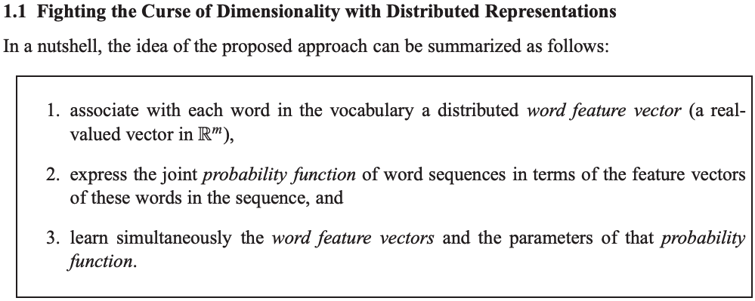
Bengio (2003)
A Neural Probabilistic Language Model. Bengio et al. JMLR (2003)

Slide 121
Bengio (2003)
A Neural Probabilistic Language Model. Bengio et al. JMLR (2003)

Slide 122
Bengio (2003)
Simultaneously learn the representation and do the modelling!
man
woman
table

Slide 123
Bengio (2003)
Simultaneously learn the representation and do the modelling!
Each circle is a specific floating point scalar
Words that are more semantically similar to one another will have embeddings that are proportionally similar, too
man
woman
table

Slide 124
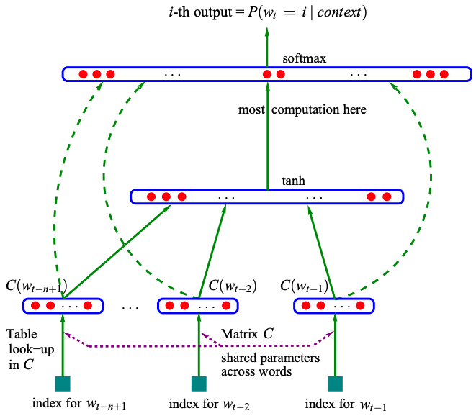
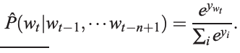
Bengio (2003)
$$y=b+Wx\text{ +}U\text{tanh}(d+Hx)$$
$$x=[C\left(w_{t−3}\right),C\left(w_{t−2}\right),C\left(w_{t−1}\right)]$$
$$θ=\{b, W,U,d,H,C\}$$
predict the most likely word w, via softmax

Slide 125
Bengio (2003)
Train the model using gradient descent:
Use our output probabilities
Calculate the cross-entropy loss
Use backprop to calculate gradients
Update all weight matrices and bias via GD
SAME AS WE DO FOR ALL OF OUR NEURAL NETS

Slide 126
Bengio (2003) Remaining Issues
This was not the first neural language model, but it was the first, highly compelling model with great results (e.g., beating n-grams)
The softmax output layer is annoyingly slow

Slide 127
Distributional Semantics
Distributional: meaning is represented by the contexts in which its used
“Distributional statements can cover all of the material of a language without requiring support from other types of information”
-- Zellig Harris. Distributional Structure. (1954)
“You shall know a word by the company it keeps”
-- John Rupert Firth. A Synopsis of Linguistics Theory. (1957)

Slide 128
Auto-regressive language models
I bought a _____
Good morning, _____
I got my ______

Slide 129
Masked language models
I bought a _____ from the bakery
Good morning, _____. Rise and shine!
I got my ______ license last week

Slide 130
How does CBOW work?

Slide 131
word2vec
Two approaches:
Continuous Bag-of-Words (CBOW)
Skip-gram w/ negative sampling

Slide 132
word2vec: CBOW
Step 1: Iterate through your entire corpus, with sliding context windows of size $N$ and step size $1$
Step 2: Using all $2N$ context words, except the center word, try to predict the center word.
Step 3: Calculate your loss and update parameters (like always)

Slide 133
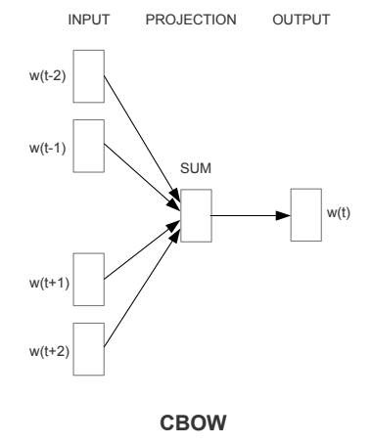
word2vec: CBOW
$y=U∗$sum($Hx\text{)}$
$$x=\left[w_{t−2},w_{t−1} ,w_{t+1} ,w_{t+2}\right]$$
$$y$$
$$U$$
$N=$# total context words
$$P$$
V x D
V x 1
$D=$ embedding size
D x 1
$$H$$
$V=$# word types
D x V
$$x$$
V x 1

Slide 134
word2vec: CBOW
Linear projection layer
Non-linear output layer (softmax)
Training in batches helps a lot

Slide 135
word2vec: results
Smaller window sizes yield embeddings such that high similarity scores indicates that the words are interchangeable
Larger window sizes (e.g., 15+) yield embeddings such that high similarity is more indicative of relatedness of the words.

Slide 136
word2vec: results
Words that appear in the same contexts are forced to gravitate toward having the same embeddings as one another
Imagine two words, w₁ and w₂, that never appear together, but they each, individually have the exact same contexts with other words. w₁ and w₂ will have ~identical embeddings!
“The” appears the most. What do you imagine its embedding is like?

Slide 137
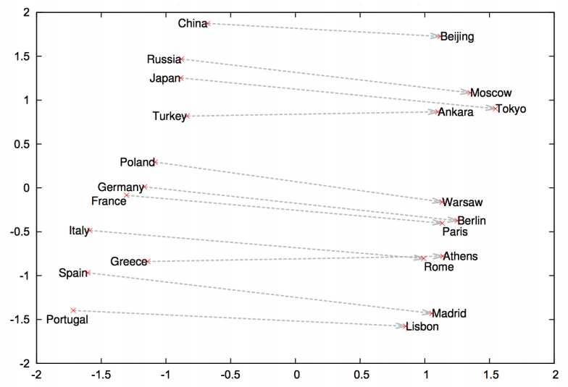
word2vec results

Slide 138
How can we evaluate word embeddings?

Slide 139
Evaluation
We cheated by looking ahead, so it’s unfair to measure perplexity against n-gram or other auto-regressive LM
Intrinsic evaluation:
Word similarity tasks
Word analogy tasks
Extrinsic evaluation:
Apply to downstream tasks (e.g., Natural language inference, entailment, question answering, information retrieval)

Slide 140
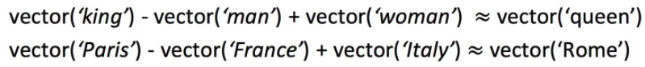
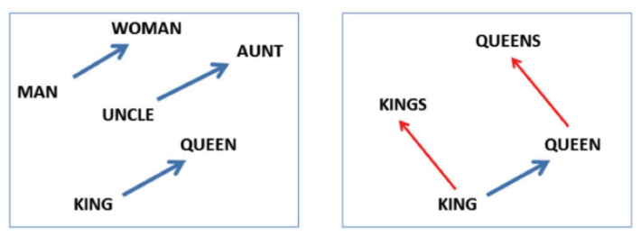
Evaluation
Word Analogy
Slide adapted from or inspired by Sam Bowman’s NYU NLP 2021

Slide 141
Remaining Challenges
Still can’t handle long-range dependencies.
Each decision is independent of the previous!
Having a small, fixed window that repeats is a bit forced and awkward

Slide 142
Lecture 5: Recurrent Neural Networks
Contextualized, Token-based Representations
Harvard
AC295/CS287r/CSCI E-115B
Chris Tanner

Slide 143
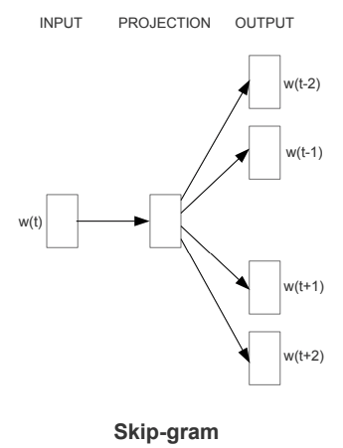
RECAP: L4
These are the learned word embeddings that we want to extract and use

Slide 144
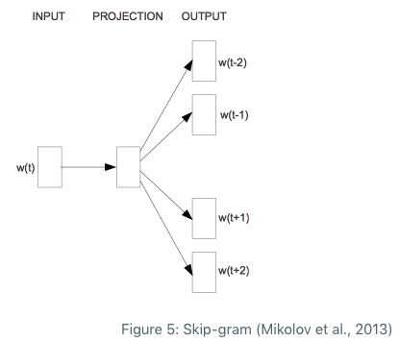

word2vec training
aardvark
apple
before
zoo
millions of books
word2vec
word embeddings

Slide 145
How can we use the learned word embeddings?

Slide 146

“The food was delicious. Amazing!”
4.8/5
4.8/5
the
food
was
delicious
amazing
+
+
Feed-forward
Neural Net
+
+
=
average embedding
average embedding
word embeddings (type-based)
approaches:
count-based/DSMs (e.g., SVD, LSA)
Predictive models (e.g., word2vec, GloVe)

Slide 147
daaang
what
supa
lit
+
Strengths:
Can create general-purpose, useful embeddings by leveraging tons of existing data
Captures semantic similarity
+
+
=
average embedding
word embeddings (type-based)
approaches:
count-based/DSMs (e.g., SVD, LSA)
Predictive models (e.g., word2vec, GloVe)

Slide 148
Issues:
Not tailored to this dataset
Out-of-vocabulary (OOV) words
Limited context
Each prediction is independent from previous
A FFNN is a clumsy, inefficient way to handle context; fixed context that is constantly being overwritten (no persistent hidden state).
Requires inputting entire context just to predict 1 word
daaang
what
supa
lit
+
+
+
=
average embedding
word embeddings (type-based)
approaches:
count-based/DSMs (e.g., SVD, LSA)
Predictive models (e.g., word2vec, GloVe)

Slide 149
word2vec Results
SkipGram w/ Negative Sampling tends to outperform CBOW
SkipGram w/ Negative Sampling is slower than CBOW
Both SkipGram and CBOW are predictive, neural models that take a type-based approach (not token-based).
Both SkipGram and CBOW can create rich word embeddings that capture both semantic and syntactic information.

Slide 150
RNNs
We especially need a system that:
Has an “infinite” concept of the past, not just a fixed window
For each new input, output the most likely next event (e.g., word)

Slide 151
Motivation
Language often has long-range dependencies:
Emily earned the top grade on the quiz! Everyone was proud of her.
Miquel earned the top grade on the quiz! Everyone was proud of him.

Slide 152
Motivation
Language is sequential in nature:
characters form words.
words form sentences.
sentences form narratives/documents
NLP folks like to operate at the word level, as that's the smallest, convenient unit of meaning.

Slide 153
RNN
$${\hat{y}}_{1}$$
$${\hat{y}}_{2}$$
$${\hat{y}}_{3}$$
$${\hat{y}}_{4}$$
Output layer
$$U$$
$$U$$
$$U$$
$$U$$
$$V$$
$$V$$
$$V$$
Hidden layer
$$W$$
$$W$$
$$W$$
$$W$$
Input layer
$$x_{1}$$
$$x_{2}$$
$$x_{3}$$
$$x_{4}$$

Slide 154
RNN
Some people find this abstract view useful.
$${\hat{y}}_{i}$$
The recurrent loop $V$ conveys that the current hidden layer is influenced by the hidden layer from the previous time step.
The initial hidden layer $h_{0}$can be initialized to 0s
Output layer
$$U$$
$$V$$
Hidden layer
$$W$$
Input layer
$$x_{i}$$

Slide 155
RNN
Some people find this abstract view useful.
Definition: an RNN is any neural net that has a non-linear combination of the recurrent state (e.g., hidden layer) and the input
$${\hat{y}}_{i}$$
Output layer
$$U$$
$$V$$
The recurrent loop $V$ conveys that the current hidden layer is influenced by the hidden layer from the previous time step.
Hidden layer
$$W$$
Input layer
$$x_{i}$$

Slide 156
RNN
$$CE\left(y^{i},{\hat{y}}^{i}\right)=−\sum_{w∈V}{y_{w}^{i}\text{log}({\hat{y}}_{w}^{i})}$$
Training Process
Error
$$CE\left(y^{1},{\hat{y}}^{1}\right)$$
$$CE\left(y^{2},{\hat{y}}^{2}\right)$$
$$CE\left(y^{3},{\hat{y}}^{3}\right)$$
$$CE\left(y^{4},{\hat{y}}^{4}\right)$$
$${\hat{y}}_{1}$$
$${\hat{y}}_{2}$$
$${\hat{y}}_{3}$$
$${\hat{y}}_{4}$$
Output layer
$$U$$
$$U$$
$$U$$
$$U$$
$$V$$
$$V$$
$$V$$
Hidden layer
$$W$$
$$W$$
$$W$$
$$W$$
Input layer
$$x_{1}$$
$$x_{2}$$
$$x_{3}$$
$$x_{4}$$
She
went
to
class

Slide 157
RNN
$$CE\left(y^{i},{\hat{y}}^{i}\right)=−\sum_{w∈V}{y_{w}^{i}\text{log}({\hat{y}}_{w}^{i})}$$
Training Process
Error
$$CE\left(y^{1},{\hat{y}}^{1}\right)$$
$$CE\left(y^{2},{\hat{y}}^{2}\right)$$
$$CE\left(y^{3},{\hat{y}}^{3}\right)$$
$$CE\left(y^{4},{\hat{y}}^{4}\right)$$
During training, regardless of our output predictions, we feed in the correct inputs
$${\hat{y}}_{1}$$
$${\hat{y}}_{2}$$
$${\hat{y}}_{3}$$
$${\hat{y}}_{4}$$
Output layer
$$U$$
$$U$$
$$U$$
$$U$$
$$V$$
$$V$$
$$V$$
Hidden layer
$$W$$
$$W$$
$$W$$
$$W$$
Input layer
$$x_{1}$$
$$x_{2}$$
$$x_{3}$$
$$x_{4}$$
She
went
to
class

Slide 158
RNN
$$CE\left(y^{i},{\hat{y}}^{i}\right)=−\sum_{w∈V}{y_{w}^{i}\text{log}({\hat{y}}_{w}^{i})}$$
Training Process
Error
$$CE\left(y^{1},{\hat{y}}^{1}\right)$$
$$CE\left(y^{2},{\hat{y}}^{2}\right)$$
$$CE\left(y^{3},{\hat{y}}^{3}\right)$$
$$CE\left(y^{4},{\hat{y}}^{4}\right)$$
went?
over?
class?
after?
Output layer
$$\hat{y}$$
$$U$$
$$U$$
$$U$$
$$U$$
$$V$$
$$V$$
$$V$$
Hidden layer
Our total loss is simply the average loss across all $T$ time steps
$$W$$
$$W$$
$$W$$
$$W$$
Input layer
She
went
to
class

Slide 159
RNN
Training Details
$\frac{∂L}{∂V}$
To update our weights (e.g. $V$), we calculate the gradient of our loss w.r.t. the repeated weight matrix (e.g., $\frac{∂L}{∂V} ).$
$$CE\left(y^{4},{\hat{y}}^{4}\right)$$
went?
over?
class?
Using the chain rule, we trace the derivative all the way back to the beginning, while summing the results.
Output layer
$$\hat{y}$$
$$U$$
$$U$$
$$U$$
$$U$$
$$V^{1}$$
$$V^{2}$$
$$V^{3}$$
Hidden layer
$$W$$
$$W$$
$$W$$
$$W$$
Input layer
She
went
to
class

Slide 160
RNN
Training Details
This backpropagation through time (BPTT) process is expensive
Instead of updating after every timestep, we tend to do so every $T$ steps (e.g., every sentence or paragraph)
This isn’t equivalent to using only a window size $T$ (a la n-grams) because we still have ‘infinite memory’

Slide 161
RNN: Generation
We can generate the most likely next event (e.g., word) by sampling from $\hat{y}$
Continue until we generate <EOS> symbol.

Slide 162
RNN: Generation
We can generate the most likely next event (e.g., word) by sampling from $\hat{y}$
Continue until we generate <EOS> symbol.
“Sorry”
Harry
shouted,
panicking
Output layer
$$U$$
$$U$$
$$U$$
$$U$$
$$V$$
$$V$$
$$V$$
Hidden layer
$$W$$
$$W$$
$$W$$
$$W$$
Input layer
$$x_{1}$$
$$x_{2}$$
$$x_{3}$$
$$x_{4}$$
<START>
“Sorry”
Harry
shouted,

Slide 163
Pros and cons of an RNN?

Slide 164
RNNs: Overview
RNN STRENGTHS?
Can handle infinite-length sequences (not just a fixed-window)
Has a “memory” of the context (thanks to the hidden layer’s recurrent loop)
Same weights used for all inputs, so word order isn’t wonky (like FFNN)
RNN ISSUES?
Slow to train (BPTT)
Due to ”infinite sequence”, gradients can easily vanish or explode
Has trouble actually making use of long-range context

Slide 165
RNNs: Vanishing and Exploding Gradients
$\frac{∂L^{4}}{∂V^{1}}$
$\frac{∂L^{4}}{∂V^{1}}=\frac{∂L^{4}}{∂V^{3}}\frac{∂V^{3}}{∂V^{2}}$ $\frac{∂V^{2}}{∂V^{1}}$
$$CE\left(y^{4},{\hat{y}}^{4}\right)$$
Output layer
$$\hat{y}$$
$$U$$
$$U$$
$$U$$
$$U$$
$$V^{1}$$
$$V^{2}$$
$$V^{3}$$
Hidden layer
$$W$$
$$W$$
$$W$$
$$W$$
Input layer
She
went
to
class

Slide 166
RNNs: Vanishing and Exploding Gradients
$\frac{∂L^{4}}{∂V^{1}}$
This long path makes it easy for the gradients to become really small or large.
If small, the far-away context will be ”forgotten.”
If large, recency bias and no context.
$\frac{∂L^{4}}{∂V^{1}}=\frac{∂L^{4}}{∂V^{3}}\frac{∂V^{3}}{∂V^{2}}$ $\frac{∂V^{2}}{∂V^{1}}$
$$CE\left(y^{4},{\hat{y}}^{4}\right)$$
Output layer
$$\hat{y}$$
$$U$$
$$U$$
$$U$$
$$U$$
$$V^{1}$$
$$V^{2}$$
$$V^{3}$$
Hidden layer
$$W$$
$$W$$
$$W$$
$$W$$
Input layer
She
went
to
class

Slide 167
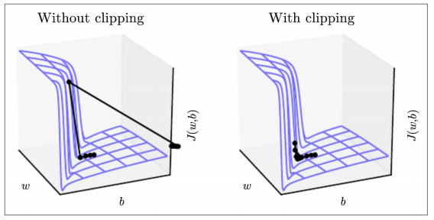
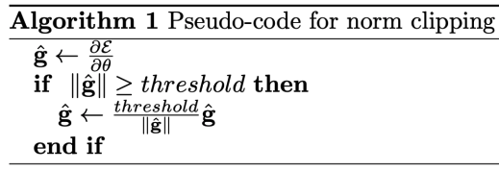
Exploding Gradients
Source: https://www.deeplearningbook.org/contents/rnn.html
Pascanu et al, 2013. http://proceedings.mlr.press/v28/pascanu13.pdf

Slide 168
Lecture 6: LSTMs
Contextualized, Token-based Representations
Harvard
AC295/CS287r/CSCI E-115B
Chris Tanner

Slide 169
How does an LSTM yield improvements?

Slide 170
LSTM
A type of RNN that is designed to better handle long-range dependencies
In ”vanilla” RNNs, the hidden state is perpetually being rewritten
In addition to a traditional hidden state h, let’s have a dedicated memory cell c for long-term events. More power to relay sequence info.

Slide 171
LSTM
At each each time step $t$, we have a hidden state $h^{t}$ and cell state $c^{t}:$
Both are vectors of length n
cell state $c^{t}$ stores long-term info
At each time step $t$, the LSTM erases, writes, and reads information from the cell $c^{t}$
$c^{t}$ never undergoes a nonlinear activation though, just – and +

Slide 172
LSTM
$C$ and $H$ relay long- and short-term memory to the hidden layer, respectively. Inside the hidden layer, there are many weights.
Output layer
$$C^{1}$$
$$C^{2}$$
Hidden layer
$$H^{1}$$
$$H^{2}$$
Input layer
$$x_{1}$$
$$x_{2}$$
$$x_{2}$$

Slide 173
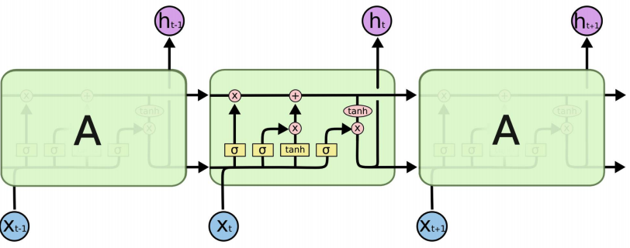
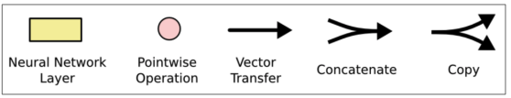
LSTM
some old memories are “forgotten”
some new memories are made
$$C^{t}$$
$$C^{t+1}$$
$$C^{t−1}$$
memory is written, erased, and read by three gates – which are influenced by $x$ and $h$
$$H^{t−1}$$
$$H^{t}$$
$$H^{t+1}$$
a nonlinear weighted version of the long-term memory becomes our short-term memory
Diagram: https://colah.github.io/posts/2015-08-Understanding-LSTMs/

Slide 174
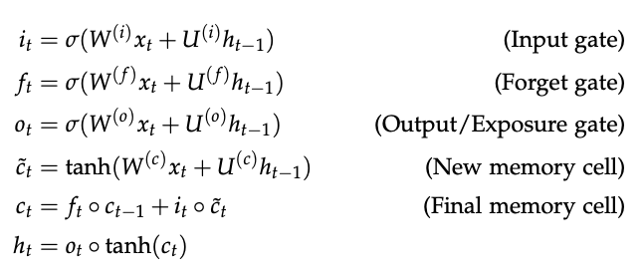
LSTM

Slide 175
LSTM
It’s still possible for LSTMs to suffer from vanishing/exploding gradients, but it’s way less likely than with vanilla RNNs:
If RNNs wish to preserve info over long contexts, it must delicately find a recurrent weight matrix $W_{h}$ that isn’t too large or small
However, LSTMs have 3 separate mechanism that adjust the flow of information (e.g., forget gate, if turned off, will preserve all info)

Slide 176
LSTM
LSTM STRENGTHS?
Almost always outperforms vanilla RNNs
Captures long-range dependencies shockingly well
LSTM ISSUES?
Has more weights to learn than vanilla RNNs; thus,
Requires a moderate amount of training data (otherwise, vanilla RNNs are better)
Can still suffer from vanishing/exploding gradients

Slide 177
How can we use LSTMs for classification?

Slide 178
Sequential Modelling
IMPORTANT
If your goal isn’t to predict the next item in a sequence, and you rather do some other classification or regression task using the sequence, then you can:
Train an aforementioned model (e.g., LSTM) as a language model
Use the hidden layers that correspond to each item in your sequence

Slide 179
Sequential Modelling
Language Modelling
1-to-1 tagging/classification
$$x_{2}$$
$$x_{3}$$
$$x_{4}$$
$$x_{5}$$
$${\hat{y}}_{1}$$
$${\hat{y}}_{2}$$
$${\hat{y}}_{3}$$
$${\hat{y}}_{4}$$
Output layer
Output layer
$$U$$
$$V$$
$$U$$
$$U$$
$$U$$
$$U$$
$$V$$
$$U$$
$$U$$
$$U$$
$$V$$
$$V$$
$$V$$
$$V$$
Hidden layer
Hidden layer
$$W$$
$$W$$
$$W$$
$$W$$
$$W$$
$$W$$
$$W$$
$$W$$
Input layer
Input layer
$$x_{1}$$
$$x_{2}$$
$$x_{3}$$
$$x_{4}$$
$$x_{1}$$
$$x_{2}$$
$$x_{3}$$
$$x_{4}$$

Slide 180
Sequential Modelling
Many-to-1 classification
Sentiment score
$${\hat{y}}_{4}$$
Output layer
$$U$$
$$V$$
$$U$$
$$U$$
$$U$$
$$V$$
$$V$$
Hidden layer
$$W$$
$$W$$
$$W$$
$$W$$
Input layer
$$x_{1}$$
$$x_{2}$$
$$x_{3}$$
$$x_{4}$$

Slide 181
Sequential Modelling
Many-to-1 classification
Sentiment score
Output layer
$$U$$
$$V$$
$$U$$
$$U$$
$$U$$
Hidden layer
$$V$$
$$V$$
$$W$$
$$W$$
$$W$$
$$W$$
Input layer
$$x_{1}$$
$$x_{2}$$
$$x_{3}$$
$$x_{4}$$

Slide 182
Summary
Distributed Representations can be:
Type-based (“word embeddings”)
Token-based (“contextualized representations/embeddings”)
Type-based models include Bengio’s 2003 and word2vec 2013
Token-based models include RNNs/LSTMs, which:
demonstrated profound results in 2015 onward.
it can be used for essentially any NLP task.

Slide 183
RNN Extensions: Bi-directional LSTMs
RNNs/LSTMs use the left-to-right context and sequentially process data.
If you have full access to the data at testing time, why not make use of the flow of information from right-to-left, also?

Slide 184
RNN Extensions: Bi-directional LSTMs
For brevity, let’s use the follow schematic to represent an RNN
$$h_{1}^{L}$$
$$h_{2}^{L}$$
$$h_{3}^{L}$$
$$h_{4}^{L}$$
$$h_{1}^{R}$$
$$h_{2}^{R}$$
$$h_{3}^{R}$$
$$h_{4}^{R}$$
Hidden layer
Input layer
$$x_{1}$$
$$x_{2}$$
$$x_{3}$$
$$x_{4}$$
$$x_{1}$$
$$x_{2}$$
$$x_{3}$$
$$x_{4}$$

Slide 185
RNN Extensions: Bi-directional LSTMs
Output layer
$${\hat{y}}_{1}$$
$${\hat{y}}_{2}$$
$${\hat{y}}_{3}$$
$${\hat{y}}_{4}$$
$$h_{1}^{R}$$
$$h_{2}^{R}$$
$$h_{3}^{R}$$
$$h_{4}^{R}$$
Concatenate the hidden layers
$$h_{1}^{L}$$
$$h_{2}^{L}$$
$$h_{3}^{L}$$
$$h_{4}^{L}$$
$$h_{1}^{L}$$
$$h_{2}^{L}$$
$$h_{3}^{L}$$
$$h_{4}^{L}$$
$$h_{1}^{R}$$
$$h_{2}^{R}$$
$$h_{3}^{R}$$
$$h_{4}^{R}$$
Hidden layer
Input layer
$$x_{1}$$
$$x_{2}$$
$$x_{3}$$
$$x_{4}$$
$$x_{1}$$
$$x_{2}$$
$$x_{3}$$
$$x_{4}$$

Slide 186
RNN Extensions: Bi-directional LSTMs
BI-LSTM STRENGTHS?
Usually performs at least as well as uni-directional RNNs/LSTMs
BI-LSTM ISSUES?
Slower to train
Only possible if access to full data is allowed

Slide 187
RNN Extensions: Stacked LSTMs
Output layer
$${\hat{y}}_{1}$$
$${\hat{y}}_{2}$$
$${\hat{y}}_{3}$$
$${\hat{y}}_{4}$$
Hidden layers provide an abstraction (holds “meaning”).
Stacking hidden layers provides increased abstractions.
Hidden layer #2
$$h_{1}^{L2}$$
$$h_{2}^{L2}$$
$$h_{3}^{L2}$$
$$h_{4}^{L2}$$
Hidden layer #1
$$h_{1}^{L}$$
$$h_{2}^{L}$$
$$h_{3}^{L}$$
$$h_{4}^{L}$$
Input layer
$$x_{1}$$
$$x_{2}$$
$$x_{3}$$
$$x_{4}$$

Slide 188
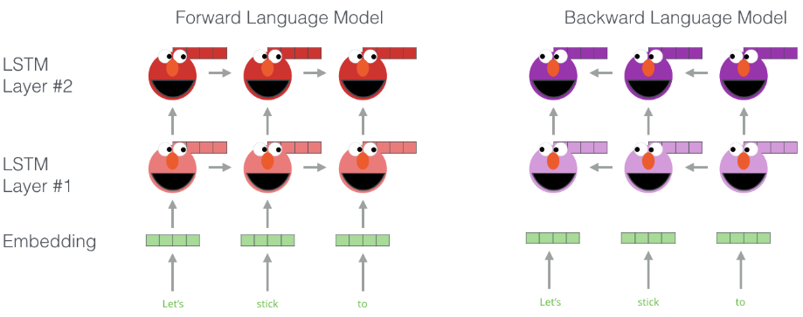
ELMo: Stacked Bi-directional LSTMs
Illustration: http://jalammar.github.io/illustrated-bert/

Slide 189
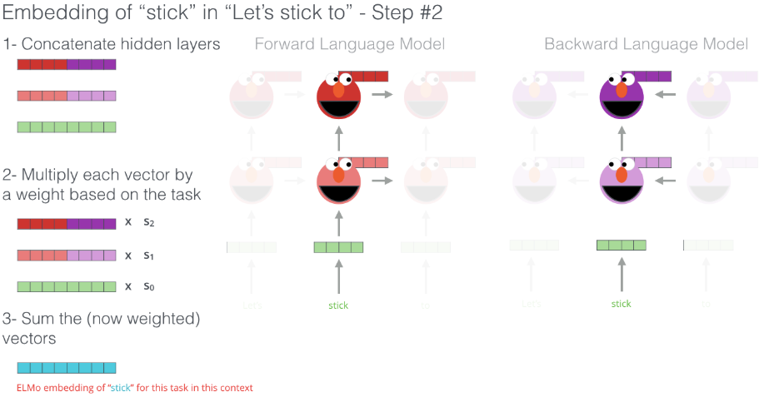
Illustration: http://jalammar.github.io/illustrated-bert/

Slide 190
RECAP: L6
Forget Gate
$$C^{t}$$
$$C^{t+1}$$
$$C^{t−1}$$
Input Gate
$$H^{t−1}$$
$$H^{t}$$
$$H^{t+1}$$
Output Gate
Diagram: https://colah.github.io/posts/2015-08-Understanding-LSTMs/

Slide 191
Outline
Beginning Concepts
Neural Foundation
Attention and Beyond

Slide 192
Outline
Beginning Concepts
Neural Foundation
Attention and Beyond

Slide 193
Lecture 7: seq2seq + Attention
Sequence Generation
Harvard
AC295/CS287r/CSCI E-115B
Chris Tanner

Slide 194
Types of Prediction
input
output
Regression
I love hiking!
0.9
Binary Classification
I love hiking!
Positive or negative
Multi-class Classification
I love hiking!
Very positive, positive, neutral, negative, or very negative
Structured Prediction
I love hiking!
PRP VBP NN
(difficult scenario when your output has exponential/infinite # of possibilities)

Slide 195
Types of Prediction (an independent axis)
Unconditioned Prediction: predict some single variable. P(X)
Example: language modelling. X = “I like hiking!”
Conditioned Prediction: predict the probability of an output variable, given the input. P(Y|X)
Example: text classification. Y = positive. X = “I like hiking!”

Slide 196
Types of Prediction (an independent axis)
Unconditioned Prediction: predict some single variable. P(X)
Example: language modelling. X = “I like hiking!”
(un)conditioned is referring to if you’re entire model is predicated upon some particular input.
Conditioned Prediction: predict the probability of an output variable, given the input. P(Y|X)
Example: text classification. Y = positive. X = “I like hiking!”

Slide 197
Types of Prediction (an independent axis)
Unconditioned Prediction: predict some single variable. P(X)
Example: language modelling. X = “I like hiking!”
Conditioned Prediction: predict the probability of an output variable, given the input. P(Y|X)
Language modelling is unconditional prediction, but one could do so by making use of conditional probabilities of X
Example: text classification. Y = positive. X = “I like hiking!”

Slide 198
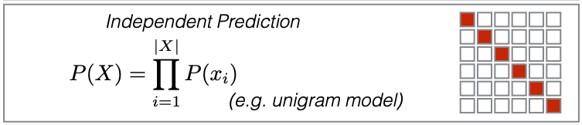
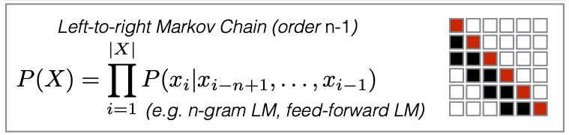
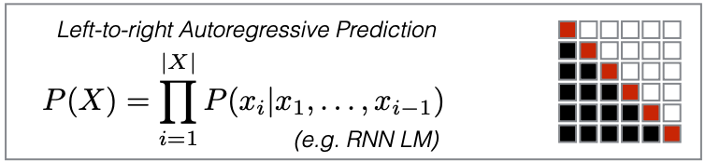
Types of Unconditional Prediction
Slide adapted from or inspired by Graham Neubig’s CMU NLP 2021

Slide 199

Types of Unconditional Prediction
Formally, a language model estimates the probability of a sequence, so this is illegal. It ”cheats”, and we call this style masked language models (not proper probability distribution and they don’t estimate sequences)
Slide adapted from or inspired by Graham Neubig’s CMU NLP 2021

Slide 200



Types of Conditional Prediction
Many-to-1 classification
$$P\left(y | X\right)$$
Many-to-many classification
Slide adapted from or inspired by Graham Neubig’s CMU NLP 2021

Slide 201
We want to produce a variable-length output (e.g., n → m predictions)
Thank you for visiting!
Děkujeme za návštěvu!

Slide 202
Sequence-to-Sequence (seq2seq)
The final hidden state of the encoder RNN is the initial state of the decoder RNN
Le
chien
brun
a
couru
<s>
$$h_{1}^{E}$$
$$h_{2}^{E}$$
$$h_{3}^{E}$$
$$h_{4}^{E}$$
$$h_{1}^{D}$$
$$h_{2}^{D}$$
$$h_{3}^{D}$$
$$h_{4}^{D}$$
$$h_{5}^{D}$$
$$h_{6}^{D}$$
Hidden layer
Input layer
The
brown
dog
ran
<s>
Le
chien
brun
a
couru
ENCODER RNN
DECODER RNN

Slide 203
Sequence-to-Sequence (seq2seq)
$${\hat{y}}_{1}$$
$${\hat{y}}_{2}$$
$${\hat{y}}_{3}$$
$${\hat{y}}_{4}$$
$${\hat{y}}_{5}$$
$${\hat{y}}_{6}$$
$$h_{1}^{E}$$
$$h_{2}^{E}$$
$$h_{3}^{E}$$
$$h_{4}^{E}$$
$$h_{1}^{D}$$
$$h_{2}^{D}$$
$$h_{3}^{D}$$
$$h_{4}^{D}$$
$$h_{5}^{D}$$
$$h_{6}^{D}$$
Hidden layer
Input layer
The
brown
dog
ran
<s>
Le
chien
brun
a
couru
ENCODER RNN
DECODER RNN

Slide 204
Sequence-to-Sequence (seq2seq)
Training occurs like RNNs typically do; the loss (from the decoder outputs) is calculated, and we update weights all the way to the beginning (encoder)
$${\hat{y}}_{1}$$
$${\hat{y}}_{2}$$
$${\hat{y}}_{3}$$
$${\hat{y}}_{4}$$
$${\hat{y}}_{5}$$
$${\hat{y}}_{6}$$
$$h_{1}^{E}$$
$$h_{2}^{E}$$
$$h_{3}^{E}$$
$$h_{4}^{E}$$
$$h_{1}^{D}$$
$$h_{2}^{D}$$
$$h_{3}^{D}$$
$$h_{4}^{D}$$
$$h_{5}^{D}$$
$$h_{6}^{D}$$
Hidden layer
Input layer
The
brown
dog
ran
<s>
Le
chien
brun
a
couru
ENCODER RNN
DECODER RNN

Slide 205
Sequence-to-Sequence (seq2seq)
Testing generates decoder outputs one word at a time, until we generate a <S> token.
Each decoder’s ${\hat{y}}_{i}$ becomes the input $x_{i+1}$
$${\hat{y}}_{1}$$
$${\hat{y}}_{2}$$
$${\hat{y}}_{3}$$
$${\hat{y}}_{4}$$
$${\hat{y}}_{5}$$
$${\hat{y}}_{6}$$
$$h_{1}^{E}$$
$$h_{2}^{E}$$
$$h_{3}^{E}$$
$$h_{4}^{E}$$
$$h_{1}^{D}$$
$$h_{2}^{D}$$
$$h_{3}^{D}$$
$$h_{4}^{D}$$
$$h_{5}^{D}$$
$$h_{6}^{D}$$
Hidden layer
Input layer
The
brown
dog
ran
<s>
Le
chien
brun
a
couru
ENCODER RNN
DECODER RNN

Slide 206
What’s a serious weakness with this seq2seq approach?

Slide 207
Sequence-to-Sequence (seq2seq)
It’s crazy that the entire “meaning” of the 1st sequence is expected to be packed into this one embedding, and that the encoder then never interacts w/ the decoder again. Hands free.
$${\hat{y}}_{1}$$
$${\hat{y}}_{2}$$
$${\hat{y}}_{3}$$
$${\hat{y}}_{4}$$
$${\hat{y}}_{5}$$
$${\hat{y}}_{6}$$
$$h_{1}^{E}$$
$$h_{2}^{E}$$
$$h_{3}^{E}$$
$$h_{4}^{E}$$
$$h_{1}^{D}$$
$$h_{2}^{D}$$
$$h_{3}^{D}$$
$$h_{4}^{D}$$
$$h_{5}^{D}$$
$$h_{6}^{D}$$
Hidden layer
Input layer
The
brown
dog
ran
<s>
Le
chien
brun
a
couru
ENCODER RNN
DECODER RNN

Slide 208
Sequence-to-Sequence (seq2seq)
Instead, what if the decoder, at each step, pays attention to a distribution of all of the encoder’s hidden states?
Intuition: when we (humans) translate a sentence, we don’t just consume the original sentence, reflect on the meaning of the last word, then regurgitate in a new language; we continuously think back at the original sentence while focusing on different parts.

Slide 209
seq2seq + Attention
Q: How do we determine how much to pay attention to each of the encoder’s hidden layers?
A: Let’s base it on our decoder’s current hidden state (our current representation of meaning) and all of the encoder’s hidden layers!
$$h_{1}^{E}$$
$$h_{2}^{E}$$
$$h_{3}^{E}$$
$$h_{4}^{E}$$
$$h_{1}^{D}$$
$$e_{4}$$
$$−0.5$$
Hidden layer
$$h_{4}^{E}$$
$$h_{1}^{D}$$
Separate FFNN
Input layer
The
brown
dog
ran
<s>
ENCODER RNN
DECODER RNN

Slide 210
seq2seq + Attention
Q: How do we determine how much to pay attention to each of the encoder’s hidden layers?
A: Let’s base it on our decoder’s current hidden state (our current representation of meaning) and all of the encoder’s hidden layers!
Attention (raw scores)
$$h_{1}^{E}$$
$$h_{2}^{E}$$
$$h_{3}^{E}$$
$$h_{4}^{E}$$
$$h_{1}^{D}$$
$$e_{1}$$
$$1.5$$
$$e_{2}$$
$$0.9$$
$$e_{3}$$
$$0.2$$
Hidden layer
$$e_{4}$$
$$−0.5$$
Attention (softmax’d)
$$a_{i}^{1}=\frac{exp⁡(e_{i})}{\sum_{i}^{N}{{exp⁡(e}_{1})}}$$
Input layer
The
brown
dog
ran
<s>
ENCODER RNN
DECODER RNN

Slide 211
seq2seq + Attention
Q: How do we determine how much to pay attention to each of the encoder’s hidden layers?
A: Let’s base it on our decoder’s current hidden state (our current representation of meaning) and all of the encoder’s hidden layers!
Attention (raw scores)
$$h_{1}^{E}$$
$$h_{2}^{E}$$
$$h_{3}^{E}$$
$$h_{4}^{E}$$
$$h_{1}^{D}$$
$$e_{1}$$
$$1.5$$
$$e_{2}$$
$$0.9$$
$$e_{3}$$
$$0.2$$
Hidden layer
$$e_{4}$$
$$−0.5$$
Attention (softmax’d)
$$a_{1}^{1}=0.51$$
Input layer
The
brown
dog
ran
<s>
$$a_{2}^{1}=0.28$$
$$a_{3}^{1}=0.14$$
ENCODER RNN
DECODER RNN
$$a_{3}^{1}=0.07$$

Slide 212
seq2seq + Attention
$$c_{1}^{D}$$
We multiply each encoder’s hidden layer by its $a_{i}^{1}$attention weights to create a context vector $c_{1}^{D}$
$$a_{1}^{1}$$
$$a_{3}^{1}$$
$$a_{4}^{1}$$
$$a_{2}^{1}$$
$$h_{1}^{E}$$
$$h_{2}^{E}$$
$$h_{3}^{E}$$
$$h_{4}^{E}$$
$$h_{1}^{D}$$
Hidden layer
Attention (softmax’d)
$$a_{1}^{1}=0.51$$
Input layer
The
brown
dog
ran
<s>
$$a_{2}^{1}=0.28$$
$$a_{3}^{1}=0.14$$
ENCODER RNN
DECODER RNN
$$a_{3}^{1}=0.07$$

Slide 213
seq2seq + Attention
REMEMBER: each attention weight $a_{i}^{j}$ is based on the decoder’s current hidden state, too.
$$c_{5}^{D}$$
Le
chien
brun
a
couru
$${\hat{y}}_{1}$$
$${\hat{y}}_{2}$$
$${\hat{y}}_{3}$$
$${\hat{y}}_{4}$$
$${\hat{y}}_{4}$$
$$a_{1}^{5}$$
$$a_{3}^{5}$$
$$a_{4}^{5}$$
$$a_{2}^{5}$$
$$h_{1}^{E}$$
$$h_{2}^{E}$$
$$h_{3}^{E}$$
$$h_{4}^{E}$$
${\text{[}h}_{1}^{D};c_{1}^{D}$]
${\text{[}h}_{2}^{D};c_{2}^{D}$]
${\text{[}h}_{3}^{D};c_{3}^{D}$]
${\text{[}h}_{4}^{D};c_{4}^{D}$]
${\text{[}h}_{5}^{D};c_{5}^{D}$]
Hidden layer
Input layer
The
brown
dog
ran
<s>
Le
chien
brun
a
ENCODER RNN
DECODER RNN

Slide 214


Popular Attention Scoring functions:
Photo credit: https://lena-voita.github.io/nlp_course/seq2seq_and_attention.html

Slide 215

seq2seq + Attention
Attention:
greatly improves seq2seq results
allows us to visualize the contribution each encoding word gave for each decoder’s word
Image source: Fig 3 in Bahdanau et al., 2015

Slide 216


Image Captioning
Input: image
Output: generated text
Show, Attend and Tell: Neural Image Caption Generation with Visual Attention. Xu et al. CVPR (2016)

Slide 217
SUMMARY
LSTMs yielded state-of-the-art results on most NLP tasks (2014-2018)
seq2seq+Attention was an even more revolutionary idea (Google Translate used it)
Attention allows us to place appropriate weight to the encoder’s hidden states
But, LSTMs require us to iteratively scan each word and wait until we’re at the end before we can do anything

Slide 218
Lecture 8: Machine Translation
And the power of Attention
Harvard
AC295/CS287r/CSCI E-115B
Chris Tanner

Slide 219
Machine Translation (MT) is an NLP task that aims to convert text from one language to another.
Thank you for visiting!
Děkujeme za návštěvu!
$$x$$
$$y$$
(source language)
(target language)
Many slides in the MT section were inspired by or adapted from Abigail See’s Stanford CS224N lecture

Slide 220
Machine Translation (MT) is an NLP task that aims to convert text from one language to another.
9th century: Al-Kindi (cryptographer)
17th century: René Descartes theorized about a universal, symbolic language 1946: Warren Weaver had a seminal publication
1950s: First huge efforts; MIT, IBM, US Government. Motivated by the Cold War.
1990s – 2014: Statistical MT.
2014 – present: Neural MT (Deep Learning)

Slide 221
We want to produce a variable-length output (e.g., n → m predictions)
Thank you for visiting!
Děkujeme za návštěvu!

Slide 222
Greedy Decoding
What’s an issue w/ greedy decoding?

Slide 223
Beam Search Decoding
We can stop generating candidates when sequences are of length N, or when we have M completed sequences
Must normalize by lengths!

Slide 224
Pros and cons of Neural MT (compared to previous approaches)

Slide 225
Neural MT
Pros:
Better performance
Uses context more robustly
Better phrases
Single model that can be optimized end-to-end (no subcomponents)
Way less manual, feature engineering

Slide 226
Neural MT
Cons:
Not too interpretable
Hard to control/ force any Language-specific aspect
A vanilla seq2seq approach can have gradient issues

Slide 227
MT Evaluation
BLEU: A similarity metric that compares the generated machine translation to a human-produced translation.
Uses n-gram precision (e.g., n=1,2,3,4,5)
Computer Generated: the dog
Target: the dog ran fast
Adds a penalty for translations that are too short (akin to recall) or over-representative (e.g., can‘t produce “the the the” and game it)
https://cloud.google.com/translate/automl/docs/evaluate has a nice example

Slide 228
2014 - present: NMT
SUMMARY
Became SOTA in just 2 years
OOV issues still need to be handled
Susceptible to training data, as always (domain mismatch issues)
Long-context is always difficult
Low-resource languages still remain a challenge
Biases from training data

Slide 229

CHECKPOINT
seq2seq doesn’t have to use RNNs/LSTMs
seq2seq doesn’t have to be used exclusively for NMT
NMT doesn’t have to use seq2seq (but it’s natural and the best we have for now)

Slide 230
Lecture 9: Self-Attention
From Attention to Self-Attention
Harvard
AC295/CS287r/CSCI E-115B
Chris Tanner

Slide 231
Goals
Each word in a sequence to be transformed into a rich, abstract representation (context embedding) based on the weighted sums of the other words in the same sequence (akin to deep CNN layers)
Inspired by Attention, we want each word to determine, “how much should I be influenced by each of my neighbors”
Want positionality

Slide 232
Self-Attention
z₁
z₂
z₃
z₄
Output representation
Self-Attention’s goal is to create great representations, z_{i}, of the input
??????
Input vectors
The
brown
dog
ran
x₁
x₂
x₃
x₄

Slide 233
Self-Attention
z₁
Output representation
Self-Attention’s goal is to create great representations, z_{i}, of the input
z₁ will be based on a weighted contribution of x₁, x₂, x₃, x₄
$$a_{1}^{1}$$
$$a_{2}^{1}$$
$$a_{3}^{1}$$
$$a_{4}^{1}$$
$a_{i}^{1}$is “just” a weight. More is happening under the hood, but it’s effectively weighting versions of x₁, x₂, x₃, x₄
Input vectors
The
brown
dog
ran
x₁
x₂
x₃
x₄

Slide 234
Self-Attention
Under the hood, each x_{i} has 3 small, associated vectors. For example, x₁ has:
Query q₁
Key k₁
Value v₁
Step 1: Our Self-Attention Head has just 3 weight matrices W_{q}, W_{k}, W_{v} in total. These same 3 weight matrices are multiplied by each x_{i} to create all vectors:
q_{i} = w_{q} x_{i}
k_{i} = w_{k} x_{i}
v_{i} = w_{v} x_{i}
q₁
k₁
v₁
q₂
k₂
v₂
q₃
k₃
v₃
q₄
k₄
v₄
The
brown
dog
ran
x₁
x₂
x₃
x₄

Slide 235
Self-Attention
Step 2: For word x₁, let’s calculate the scores s₁, s₂, s₃, s₄, which represent how much attention to pay to each respective ”word” v_{i}
s₁ = q₁$⋅$k₁ = 112
q₁
k₁
v₁
q₂
k₂
v₂
q₃
k₃
v₃
q₄
k₄
v₄
The
brown
dog
ran
x₁
x₂
x₃
x₄
Notes:
A given word’s query vector should be more similar to word’s key vector than it is to any other word’s key vector.
We take the dot product, so their magnitudes should be higher than the others.
The v vector for each word will likely be similar to the original word vector, since we ultimately weight these vectors, not our original x vectors.

Slide 236
Self-Attention
Step 2: For word x₁, let’s calculate the scores s₁, s₂, s₃, s₄, which represent how much attention to pay to each respective ”word” v_{i}
s₂ = q₁$⋅$k₂ = 96
s₁ = q₁$⋅$k₁ = 112
q₁
k₁
v₁
q₂
k₂
v₂
q₃
k₃
v₃
q₄
k₄
v₄
The
brown
dog
ran
x₁
x₂
x₃
x₄
Notes:
A given word’s query vector should be more similar to word’s key vector than it is to any other word’s key vector.
We take the dot product, so their magnitudes should be higher than the others.
The v vector for each word will likely be similar to the original word vector, since we ultimately weight these vectors, not our original x vectors.

Slide 237
Self-Attention
Step 2: For word x₁, let’s calculate the scores s₁, s₂, s₃, s₄, which represent how much attention to pay to each respective ”word” v_{i}
s₃ = q₁$⋅$k₃ = 16
s₂ = q₁$⋅$k₂ = 96
s₁ = q₁$⋅$k₁ = 112
q₁
k₁
v₁
q₂
k₂
v₂
q₃
k₃
v₃
q₄
k₄
v₄
The
brown
dog
ran
x₁
x₂
x₃
x₄
Notes:
A given word’s query vector should be more similar to word’s key vector than it is to any other word’s key vector.
We take the dot product, so their magnitudes should be higher than the others.
The v vector for each word will likely be similar to the original word vector, since we ultimately weight these vectors, not our original x vectors.

Slide 238
Self-Attention
Step 2: For word x₁, let’s calculate the scores s₁, s₂, s₃, s₄, which represent how much attention to pay to each respective ”word” v_{i}
s₄ = q₁$⋅$k₄ = 8
s₃ = q₁$⋅$k₃ = 16
s₂ = q₁$⋅$k₂ = 96
s₁ = q₁$⋅$k₁ = 112
q₁
k₁
v₁
q₂
k₂
v₂
q₃
k₃
v₃
q₄
k₄
v₄
The
brown
dog
ran
x₁
x₂
x₃
x₄
Notes:
A given word’s query vector should be more similar to word’s key vector than it is to any other word’s key vector.
We take the dot product, so their magnitudes should be higher than the others.
The v vector for each word will likely be similar to the original word vector, since we ultimately weight these vectors, not our original x vectors.

Slide 239
Self-Attention
Step 3: Our scores s₁, s₂, s₃, s₄ don’t sum to 1. Let’s divide by $√len(k_{i})$ and softmax it
s₄ = q₁$⋅$k₄ = 8
a₄ = $σ(s_{4}/8)$ = 0
s₃ = q₁$⋅$k₃ = 16
$\text{a}\text{3}\text{ =} σ(s_{3}/8)$ = .01
s₂ = q₁$⋅$k₂ = 96
a₂ = $σ(s_{2}/8)$ = .12
s₁ = q₁$⋅$k₁ = 112
a₁ = $σ(s_{1}/8)$ = .87
q₁
k₁
v₁
q₂
k₂
v₂
q₃
k₃
v₃
q₄
k₄
v₄
The
brown
dog
ran
x₁
x₂
x₃
x₄
Notes:
We then normalize these attention scores

Slide 240
Self-Attention
Step 3: Our scores s₁, s₂, s₃, s₄ don’t sum to 1. Let’s divide by $√len(k_{i})$ and softmax it
s₄ = q₁$⋅$k₄ = 8
a₄ = $σ(s_{4}/8)$ = 0
Instead of these a_{i} values directly weighting our original x_{i} word vectors, they directly weight our v_{i} vectors.
s₃ = q₁$⋅$k₃ = 16
$\text{a}\text{3}\text{ =} σ(s_{3}/8)$ = .01
s₂ = q₁$⋅$k₂ = 96
a₂ = $σ(s_{2}/8)$ = .12
s₁ = q₁$⋅$k₁ = 112
a₁ = $σ(s_{1}/8)$ = .87
q₁
k₁
v₁
q₂
k₂
v₂
q₃
k₃
v₃
q₄
k₄
v₄
The
brown
dog
ran
x₁
x₂
x₃
x₄

Slide 241
Self-Attention
Step 4: Let’s weight our v_{i} vectors and simply sum them up!
z₁
z₁ = a₁$⋅$v₁ + a₂$⋅$v₂ + a₃$⋅$v₃ + a₄$⋅$v₄
= 0.87$⋅$v₁ + 0.12$⋅$v₂ + 0.01$⋅$v₃ + 0$⋅$v₄
q₁
k₁
v₁
q₂
k₂
v₂
q₃
k₃
v₃
q₄
k₄
v₄
The
brown
dog
ran
x₁
x₂
x₃
x₄

Slide 242
Self-Attention
Step 5: We repeat this for all other words, yielding us with great, new z_{i} representations!
z₂
z₂ = a₁$⋅$v₁ + a₂$⋅$v₂ + a₃$⋅$v₃ + a₄$⋅$v₄
q₁
k₁
v₁
q₂
k₂
v₂
q₃
k₃
v₃
q₄
k₄
v₄
The
brown
dog
ran
x₁
x₂
x₃
x₄

Slide 243
Self-Attention
Step 5: We repeat this for all other words, yielding us with great, new z_{i} representations!
z₃
z₃ = a₁$⋅$v₁ + a₂$⋅$v₂ + a₃$⋅$v₃ + a₄$⋅$v₄
q₁
k₁
v₁
q₂
k₂
v₂
q₃
k₃
v₃
q₄
k₄
v₄
The
brown
dog
ran
x₁
x₂
x₃
x₄

Slide 244
Self-Attention
Step 5: We repeat this for all other words, yielding us with great, new z_{i} representations!
z₄
z₄ = a₁$⋅$v₁ + a₂$⋅$v₂ + a₃$⋅$v₃ + a₄$⋅$v₄
q₁
k₁
v₁
q₂
k₂
v₂
q₃
k₃
v₃
q₄
k₄
v₄
The
brown
dog
ran
x₁
x₂
x₃
x₄

Slide 245
Self-Attention
Tada! Now we have great, new representations z_{i} via a self-attention head
z₁
z₂
z₃
z₄
Self-attention Head
q₁
k₁
v₁
q₂
k₂
v₂
q₃
k₃
v₃
q₄
k₄
v₄
The
brown
dog
ran
x₁
x₂
x₃
x₄

Slide 246
Self-Attention may seem strikingly like Attention in seq2seq models
Q: What are the key, query, value vectors in the Attention setup?

Slide 247
Lecture 10: Transformers
From Self-Attention to Transformers
Harvard
AC295/CS287r/CSCI E-115B
Chris Tanner

Slide 248
Transformer Encoder
r₁
r₂
r₃
r₄
Encoder
Yay! Our r_{i} vectors are our new representations, and this entire process is called a Transformer Encoder
Problem: there is no concept of positionality. Words are weighted as if a “bag of words”
Solution: add to each input word x_{i} a positional encoding $\sim sin\left(i\right)cos⁡(i)$
FFNN
+ x Residual Connections +LayerNorm
z₁
z₂
z₃
z₄
Self-attention Head
The
brown
dog
ran
x₁
x₂
x₃
x₄

Slide 249
A Self-Attention Head has just one set of query/key/value weight matrices w_{q,} w_{k,} w_{v}
Words can relate in many ways, so it’s restrictive to rely on just one Self-Attention Head in the system.
Let’s create Multi-headed Self-Attention

Slide 250
Transformer Encoder
To recap: all of this looks fancy, but ultimately it’s just producing a very good contextualized embedding r_{i} of each word x_{i}
Why stop with just 1 Transformer Encoder? We could stack several!
r₁
r₂
r₃
r₄
Encoder #3
Encoder #2
Encoder #1
The
brown
dog
ran
x₁
x₂
x₃
x₄

Slide 251

Transformer Decoder
r₁
r₂
r₃
r₄
Decoder
FFNN
=
+ x Residual Connections +LayerNorm
z_{1A}
z_{1B}
z_{1C}
z_{2A}
z_{2B}
z_{2C}
z_{3A}
z_{3B}
z_{3C}
z_{4A}
z_{4B}
z_{4C}
Masked Self-attention Head
<s>
El
perro
marrón
x₁
x₂
x₃
x₄

Slide 252
Where does the Decoder Attend to?

Slide 253
Transformer Encoders and Decoders
hnědý
pes
běžel
Transformer
NOTE
Encoder #8
Decoder #8
Transformer Decoders are identical to the Encoders, except they have an additional Attention Head in between the Self-Attention and FFNN layers.
This additional Attention Head focuses on parts of the encoder’s representations.
Encoder #2
Decoder #2
Encoder #1
Decoder #1
The
brown
dog
ran
x₁
x₂
x₃
x₄

Slide 254
Transformer Encoders and Decoders
hnědý
pes
běžel
Transformer
IMPORTANT
Encoder #8
Decoder #8
The Transformer Decoders have positional embeddings, too, just like the Encoders.
Critically, each position is only allowed to attend to the previous indices. This masked Attention preserves it as being an auto-regressive LM.
Encoder #2
Decoder #2
Encoder #1
Decoder #1
The
brown
dog
ran
x₁
x₂
x₃
x₄

Slide 255

https://jalammar.github.io/illustrated-transformer/

Slide 256

Loss Function: cross-entropy (predicting translated word)
Training Time: ~4 days on (8) GPUs

Slide 257
What if we don’t want to decode/translate?
Just want to perform a particular task (e.g., classification)
Want even more robust, flexible, rich representation!
Want positionality to play a more explicit role, while not being restricted to a particular form (e.g., CNNs)

Slide 258
Lecture 11: BERT
The Power of Transformer Encoders
Harvard
AC295/CS287r/CSCI E-115B
Chris Tanner

Slide 259
BERT
Bidirectional Encoder Representations from Transformers
Let’s only use Transformer Encoders, no Decoders

Slide 260
Types of Data
UNLABELLED
Raw text (e.g., web pages)
Parallel corpora (e.g., for translations)
LABELLED
Linear/unstructured
N-to-1 (e.g., sentiment analysis)
N-to-N (e.g., POS tagging)
N-to-M (e.g., summarization)
Structured
Dependency parse trees
Constituency parse trees
Semantic Role Labelling

Slide 261
Types of Data
UNLABELLED
Raw text (e.g., web pages)
Parallel corpora (e.g., for translations)
LABELLED
Linear/unstructured
N-to-1 (e.g., sentiment analysis)
N-to-N (e.g., POS tagging)
N-to-M (e.g., summarization)
Structured
Dependency parse trees
Constituency parse trees
Semantic Role Labelling
We most often about this type of data

Slide 262
Types of Data
Labelled data is a scarce commodity.
How can we get more of it?
How can we leverage more plentiful, other data (either labelled or unlabelled) so as to make better use of our limited labelled data?

Slide 263
Types of Learning
One axis that refers to our style of using/learning our data:
Multi-task Learning
Transfer Learning
Pre-training
One axis that hinges upon the type of data we have:
Supervised Learning
Unsupervised Learning
Self-supervised Learning
Semi-supervised Learning

Slide 264
Types of Learning
One axis that refers to our style of using/learning our data:
Multi-task Learning = general term for training on multiple tasks
Transfer Learning = type of multi-task learning where we only care about one of the tasks
Pre-training = type of transfer learning where we first focus on one objective
See chalkboard for example

Slide 265
Multi-task heuristics
Ideally, your tasks should be closely related (e.g., constituency parsing and dependency parsing)
Multi-task learning may help improve the task that has limited data
General domain → specific domain (e.g., all of the web’s text -> law text)
High-resourced language → low-resourced language (e.g., English -> Igbo)
Unlabelled text → labelled text (e.g., language model -> named entity recognition)
Inspired by or based on http://www.phontron.com/class/anlp2021/assets/slides/anlp-08-pretraining.pdf

Slide 266
Naming convention
Many deep learning models, including pre-trained ones with cute names (e.g., ELMo, BERT, ALBERT, GPT-3), refer to an exact combination of:
The model’s architecture
The training objective to pre-train (e.g., MLM prediction)
The data (e.g., Google BooksCorpus, Wikipedia)
Many people abuse the terms and swap out components.

Slide 267
What are the two training objectives of BERT?

Slide 268
BERT
brown
lazy
playful
0.92
0.05
0.03
BERT has 2 training objectives:
BERT
1. Predict the Masked word (a la CBOW)
15% of all input words are randomly masked.
80% become [MASK]
10% become revert back
10% become are deliberately corrupted as wrong words
Encoder #8
Encoder #2
Encoder #1
<CLS>
The
brown
dog
x₁
x₂
x₃
x₄

Slide 269
BERT
brown
lazy
playful
0.92
0.05
0.03
BERT has 2 training objectives:
BERT
2. Two sentences are fed in at a time. Predict the if the second sentence of input truly follows the first one or not.
Encoder #8
Encoder #2
Encoder #1
<CLS>
The
brown
dog
x₁
x₂
x₃
x₄

Slide 270

BERT
NOTE: BERT also embeds the inputs by their WordPiece embeddings.
WordPiece is a sub-word tokenization learns to merge and use characters based on which pairs maximize the likelihood of the training data if added to the vocab.
Source: original BERT paper: https://arxiv.org/pdf/1810.04805.pdf

Slide 271
Three ways to Attend
Encoder-Decoder Attention
Encoder Self-Attention
Decoder Masked Self-Attention

Slide 272

BERT (alternate view)
https://jalammar.github.io/illustrated-bert/

Slide 273

BERT (alternate view)
https://jalammar.github.io/illustrated-bert/

Slide 274

BERT’s inputs
https://arxiv.org/pdf/1810.04805.pdf

Slide 275




RECAP: L11
BERT is easy to fine-tune on any other classification task
replace the top layer
ensure your inputs are tokenized the same way as training, and no OOV tokens
usually best to allow the original BERT weights to adjust, too (don’t freeze)
https://jalammar.github.io/illustrated-transformer/

Slide 276
Extensions
Transformer-Encoders
BERT
ALBERT (A Lite BERT …)
RoBERTa (A Robustly Optimized BERT …)
DistilBERT (small BERT)
ELECTRA (Pre-training Text Encoders as Discriminators not Generators)
Longformer (Long-Document Transformer)

Slide 277
Extensions
Autoregressive
GPT (Generative Pre-training)
CTRL (Conditional Transformer LM for Controllable Generation)
Reformer
XLNet

Slide 278
Lecture 12: GPT-2
Generative pre-training
Harvard
AC295/CS287r/CSCI E-115B
Chris Tanner

Slide 279
Transformer
What if we want to generate a new output sequence?
GPT-2 model to the rescue!
Generative Pre-trained Transformer 2

Slide 280
Does GPT have an encoder, decoder, both, or none?

Slide 281

GPT-2 (a Transformer)
GPT-2 uses only Transformer Decoders (no Encoders) to generate new sequences from scratch or from a starting sequence
Image by http://jalammar.github.io/illustrated-gpt2/

Slide 282
How is masking performed?

Slide 283

GPT-2 (a Transformer)
There is no Attention (since there is no Transformer Encoder to attend to). So, there is only Self-Attention.
As it processes each word/token, it masks the “future” words and conditions on and attends to the previous words
Image by http://jalammar.github.io/illustrated-gpt2/

Slide 284

GPT-2 (a Transformer)
As it processes each word/token, it masks the “future” words and conditions on and attends to the previous words
Image by http://jalammar.github.io/illustrated-gpt2/

Slide 285

GPT-2 (a Transformer)
Image by http://jalammar.github.io/illustrated-gpt2/

Slide 286
GPT-2 (a Transformer)
Technically, it doesn’t use words as input but Byte Pair Encodings (sub-words), similar to BERT’s WordPieces.
Includes positional embeddings as part of the input, too.
Easy to fine-tune on your own dataset (language)

Slide 287

GPT-2 (a Transformer)
Image by http://jalammar.github.io/illustrated-gpt2/

Slide 288

GPT-2’s Masked Attention
For efficiency, we can still calculate all query-key calculations with matrix multiplications, then mask before softmax’ing.
Image by http://jalammar.github.io/illustrated-gpt2/

Slide 289

GPT-2’s Masked Attention
For efficiency, we can still calculate all query-key calculations with matrix multiplications, then mask before softmax’ing.
Image by http://jalammar.github.io/illustrated-gpt2/

Slide 290

GPT-2’s Masked Attention
For efficiency, we can still calculate all query-key calculations with matrix multiplications, then mask before softmax’ing.
Image by http://jalammar.github.io/illustrated-gpt2/

Slide 291

GPT-2’s
Representations are propagated upwards through the network
Image by http://jalammar.github.io/illustrated-gpt2/

Slide 292

GPT-2’s
Self-attention is otherwise identical to what we saw in BERT
Image by http://jalammar.github.io/illustrated-gpt2/

Slide 293

GPT-2’s
Can have Multiple Self-Attention heads
Image by http://jalammar.github.io/illustrated-gpt2/

Slide 294

GPT-2’s
Each Self-Attention head is responsible for exactly 1 resulting, output embedding
Image by http://jalammar.github.io/illustrated-gpt2/

Slide 295
GPT-2’s
Remember, these Masked Self-Attention layers are fed into a FFNN
Image by http://jalammar.github.io/illustrated-gpt2/

Slide 296

GPT-2’s
Image by http://jalammar.github.io/illustrated-gpt2/

Slide 297


Each Decoder block has its own weights (e.g., $W_{k}, W_{q}, W_{v}$)
But the entire model only has 1 token-embedding weight matrix and positional encoding weight matrix. This helps all the blocks to work together and supplement their captured aspects
Image by http://jalammar.github.io/illustrated-gpt2/

Slide 298
GPT-1
Model: Transformer Decoders we just described
Objective: next word prediction (cross-entropy loss)
Data: BooksCorpus (7k books from a variety of genres, such as Adventure, Fantasy, and Romance)

Slide 299

https://s3-us-west-2.amazonaws.com/openai-assets/research-covers/language-unsupervised/language_understanding_paper.pdf

Slide 300
What insights did GPT-2 yield over GPT-1?

Slide 301

GPT-2 is identical to GPT-1, but:
has Layer normalization in between each sub-block (as we’ve already seen)
Vocab extended to 50,257 tokens and context size increased from 512 to 1024
Data: 8 million docs from the web (Common Crawl), minus Wikipedia

Slide 302
You can finagle the system to yield synthetic predictions.
Children’s Book Test (CBT) is a classification task. Fill-in-the-blank, and you predict which of the 10 possible choices is correct.
You can compute the probability of each choice + its ending.

Slide 303
You can finagle the system to yield synthetic predictions.
LAMBADA dataset tests model’s ability to understand long-range dependencies.
Task: predict the final word of sentences which humans need 50+ tokens of context in order to accurately predict.

Slide 304

GPT-2 Results

Slide 305
You can finagle the system to yield synthetic predictions.
Summarization. The add the text “TL;DR:” after an article, then generate 100 tokens with top-2 random sampling, then extract the first 3 sentences.

Slide 306

GPT-2 Results

Slide 307
GPT-2 Results

Slide 308
GPT-2 Results
Easy to fine-tune on your own dataset (language)
SYSTEM PROMPT (HUMAN-WRITTEN)
A train carriage containing controlled nuclear materials was stolen in Cincinnati today. Its whereabouts are unknown.
MODEL COMPLETION (MACHINE-WRITTEN, FIRST TRY)
The incident occurred on the downtown train line, which runs from Covington and Ashland stations.
In an email to Ohio news outlets, the U.S. Department of Energy said it is working with the Federal Railroad Administration to find the thief.
“The theft of this nuclear material will have significant negative consequences on public and environmental health, our workforce and the economy of our nation,” said Tom Hicks, the U.S. Energy Secretary, in a statement. “Our top priority is to secure the theft and ensure it doesn’t happen again.”
The stolen material was taken from the University of Cincinnati’s Research Triangle Park nuclear research site, according to a news release from Department officials.
The Nuclear Regulatory Commission did not immediately release any information.

Slide 309
GPT-2 (a Transformer Decoder)
GPT-2 is:
trained on 40GB of text data (8M webpages)!
1.5B parameters
GPT-3 is an even bigger version (175B parameters) of GPT-2, but isn’t open-source
Yay, for transfer learning!

Slide 310

Concerns
There are several issues to be aware of:
It is very costly to train these large models. The companies who develop these models easily spend an entire month training one model, which uses incredible amounts of electricity.
BERT alone is estimated to cost over $1M for their final models
Source: https://arxiv.org/pdf/2004.08900.pdf

Slide 311

Concerns
It is very costly to train these large models.
Source: https://arxiv.org/pdf/2004.08900.pdf

Slide 312


Concerns

Slide 313
Concerns
Further, these very large language models have been shown to be biased (e.g., in terms of gender, race, sex, etc).
Converting from one language to another often converts gender neutral pronouns to sexist stereotypes
Using these powerful LMs comes with risks of producing such text and/or evaluating/predicting tasks based on these biased assumptions.
People are researching how to improve this

Slide 314
Concerns
As computer-generated text starts to become indistinguishable from authentic, human-generated text, consider the ethical impact of fraudulently claiming text to be from a particular author.
If used maliciously, it can easily contribute toward the problem of Fake News

Slide 315
Summary
NLP is incredibly fun, with infinite number of problems to work on
Neural models allow us to easily represent words as distributed representations
Input unique word (or sub-words) as tokens
Recurrent models can be for capturing the sequential nature, but it puts too much responsibility on the model to keep track of the entire meaning and to pass it onwards

Slide 316
Summary
Transformers allow for more complete, free access to everything (unless masked) at once
It’s very useful to pre-train a large unsupervised/self-supervised LM then fine-tune on your particular task (replace the top layer, so that it can work)

Slide 317
Outstanding Questions
What is the model actually learning → probing tasks/interpretability
biases exist within data & model. How can we improve this? → debiasing
How can we make models faster, smaller, more robust? → distillation, robustness
Can we better understand the sensitivity of models and protect against vulnerabilities? → adversarial NLP
How can we better handle low-resource/scarce/unlabelled data?
How can we get better at complex tasks? (e.g., coreference resolution, tasks that require commonsense reasoning and leveraging real-world knowledge)
How can we get better at long-form documents, mixed-mediums? (e.g., tabular data, images, structured text such as scientific papers)

